Slide 1

Complementary and Integrative Health for Sickle Cell Pain: Mechanistic Approaches
Wally R Smith, MD
Florence Neal Cooper Smith Professor of Sickle Cell Disease
Virginia Commonwealth University
Richmond, VA

Slide 2

COI Disclosures
Consultant, advisor, investigator
Pfizer
Agios
Novartis
Fulcrum
Alexion
DSMB
Novo-Nordisk

Slide 3
Unmet Need: Major Gaps In Pain Care
DEFINITIONS OF PAIN CONDITIONS
PAIN CARE GUIDELINES
FACILITIES TO DELIVER HIGH QUALITY PAIN CARE
QUALITY IMPROVEMENT INITIATIVES
http://nationalacademies.org/hmd/reports/2011/relieving-pain-in-america-a-blueprint-for-transforming-prevention-care-education-research.aspx

Slide 4
Only a Small % SCD Pain Days Spent in Hospital
Pain Intensity
Mean
Std
Dev
Provider-Treated VOC days
Utilization
5.9
0.1
3.5%
Self-treated VOC days
Crisis w/o utilization
5.0
0.1
12.7%
Self-treated pain days
3.9
0.1
38.3%
Pain w/o crisis or util.
No-pain days
45.5%
No Pain
0
0
*Percentage of days. Utilization= utilization with or without crisis or pain; Crisis= crisis without utilization; Pain= pain without crisis or utilization
Adapted from Smith WR, et. al. Ann Intern Med 2008 Jan 15, 148(2):94-101
Notes:
Focus on yellow , then orange
People spend 3-4 time as many days at home in a crisis as they spend in hospital .
Everyday spent in the hospital in crisis = 3-4days in crisis at home
---
This slide highlights that only a small percentage of days with acute pain from vaso-occlusive crises (VOC) are treated in hospitals. The majority of days are either self-managed (38.3%) or have no pain (45.5%). Provider-treated VOC days represent a mere 3.5%, while 12.7% are self-treated VOC days. The right table shows pain intensity by category, with higher mean intensity during utilization and crisis periods. This data underscores the significant burden of untreated or poorly managed pain outside clinical settings.

Slide 5
Acute SCD Pain Definition
Diagnosis of SCD by lab
Not explained by exam signs
One sign or evidence of functional impairment
Pain > 2 hours but < 10 days
Acute SCD Pain
Subtypes
absence of chronic SCD pain
presence of chronic SCD pain
Sources
Analgesic, Anesthetic, and Addiction Clinical Trial Translations Innovations Opportunities and Networks-American Pain Society Pain Taxonomy initiative.
Field JJ, Ballas SK, Campbell CM, Crosby LE, Dampier C, Darbari DS, McClish DK, Smith WR, Zempsky WT. Analgesic, Anesthetic, and 10.1016/j.jpain.2018.12.003. [Epub ahead of print] PubMed PMID: 30578848. Addiction Clinical Trial Translations, Innovations, Opportunities, and Networks-American Pain Society-American Academy of Pain Medicine Pain Taxonomy Diagnostic Criteria for Acute Sickle Cell Disease Pain. J Pain. 2018 Dec 19. pii: S1526-5900(18)31017-4. doi:

Slide 6
Chronic SCD Pain Definition
Diagnosis of SCD by lab
Chronic SCD Pain
One sign of pain sensitivity
Pain on most days over 6 months
Subtypes
without contributory disease complications
with contributory disease complications
with mixed pain types
Sources:
Analgesic, Anesthetic, and Addiction Clinical Trial Translations Innovations Opportunities and Networks-American Pain Society Pain Taxonomy initiative. ; Dampier C, Palermo TM, Darbari DS, Hassell K, Smith W, Zempsky W. AAPT Diagnostic Criteria for Chronic Sickle Cell Disease Pain. J Pain. 2017 May;18(5):490-498. doi: 10.1016/j.jpain.2016.12.016. Epub 2017 Jan 5. PubMed PMID: 28065813.i

Slide 7




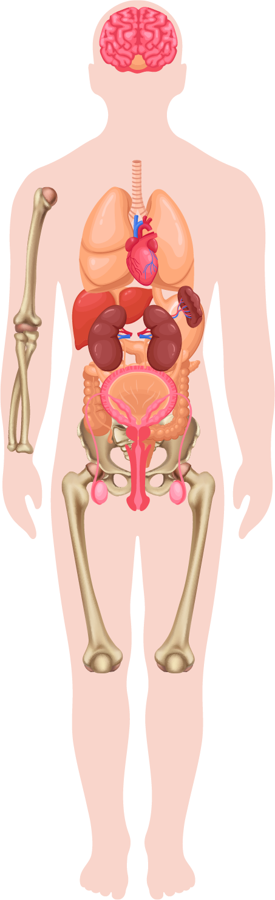




Pain Computer
Multimodal input devices
Central Processing Unit
Multimodal output devices
Pain Behavior
Pain Interpretation
Pain Disruption/
disability
Pain Emotion
Pain Signal
Pain Processing/perception
Feedback, downregulation, back-signalling
Feedback, downregulation, back-signalling

Slide 8
Nociplastic Pain
Spontaneous and/or widespread pain
Fatigue, sleep, memory, mood disturbance
Hyperalgesia
increased response to a (already) painful stimulus, e.g. pin prick.
Allodynia
response to a normally innocuous stimulus, e.g. q-tip, butterfly.
1: von Hehn CA, Baron R, Woolf CJ. Deconstructing the neuropathic pain phenotype to reveal neural mechanisms. Neuron. 2012 Feb 23;73(4):638-52. Review. PubMed PMID: 22365541; PubMed Central PMCID: PMC3319438. Wilkie DJ, Molokie R, Boyd-Seal D, Suarez ML, Kim YO, Zong S, Wittert H, Zhao Z, Saunthararajah Y, Wang ZJ. Patient-reported outcomes: descriptors of nociceptive and neuropathic pain and barriers to effective pain management in adult outpatients with sickle cell disease. J Natl Med Assoc. 2010 Jan;102(1):18-27.
Fitzcharles, et al, Lancet 2021; 397: 2098–110

Slide 9
Pain Transformation in SCD
Usual Pain phenotype
15-20 Years of recurrent Vaso-occlusive damage to CNS neurons, glia
Hypernociceptive phenotype
Usual pain sensitivity
Afferent pain-modulation balance
Central sensitization (?)
Elevated cerebral blood flow
Cerebral Infarction
Frontal Lobe (Cognitive processing centers)
Parietal Lobe (Sensory/Touch/Pain
Temporal Lobe (Memory/Auditory)
Cerebral hypoxia
Decreased pain cognition
Cognitive deficits
Afferent pain modulation imbalance?
attenuation of modulatory, regulatory network
attenuation of afferent network (RED DMN, etc)
Neuroplasticity
Central sensitization
Daniel M Sop, MS^{1,2}, Yue May Zhang, MS¹, Wally R Smith, MD¹ The Impact of Silent Cerebral Ischemia on Pain Sensitivity in Adult SCD patients Compared to Healthy Control. Submitted, Blood.
Daniel M Sop, MS^{1,2}, Yue May Zhang, MS¹, Wally R Smith, MD^{1.} Cerebral Blood Flow and Pain Perception in Sickle Cell Disease: A Mediation Analysis. Submitted, Blood.
Yue May Zhang, MS¹, Daniel M Sop, MS^{1, 2} , Wally R Smith, MD¹ Enhanced Pain Sensitivity in Adult Sickle Cell Disease Patients: Potential Mediating Factors. Submitted, Blood
*Sop D, Steinberg JL, Jordan J, Crouch T, Zhang YM, Smith W. Association of Cerebral Hemodynamics and Anemia on Processing Speed in Adults with Sickle Cell Disease. J Neurol Exp Neural Sci. 2023;5(1):150. doi: 10.29011/2577-1442.100050. Epub 2023 Jul 24. PMID: 37645351; PMCID: PMC10464389.
Latremoliere A, Woolf CJ. Central sensitization: a generator of pain hypersensitivity by central neural plasticity. J Pain. 2009 Sep;10(9):895-926. doi: 10.1016/j.jpain.2009.06.012. PMID: 19712899; PMCID: PMC2750819.

Slide 10
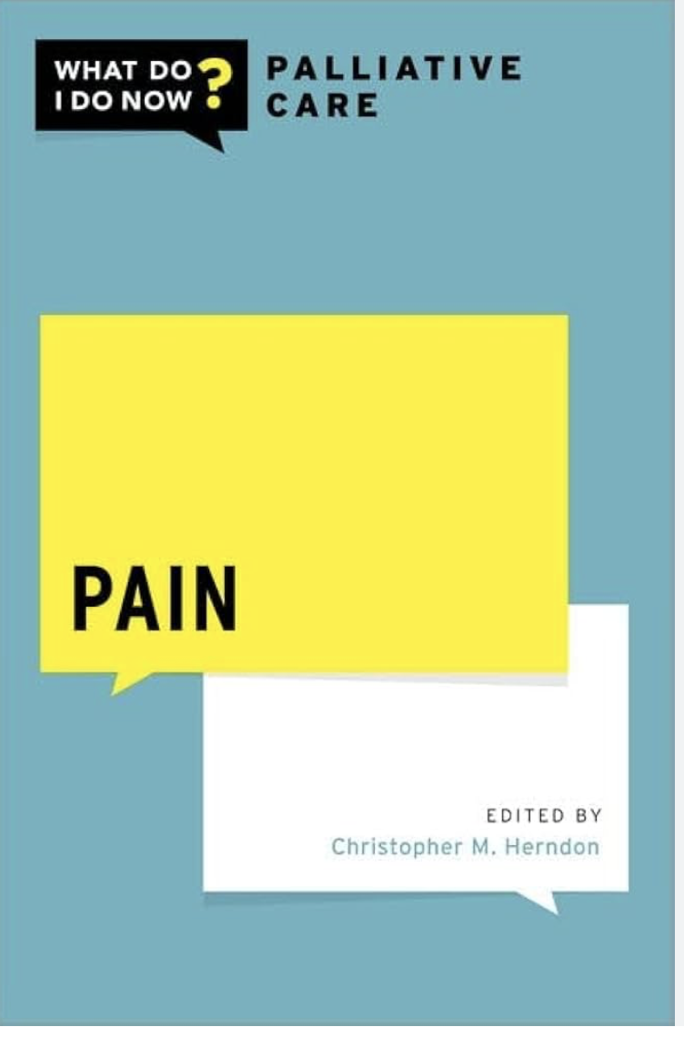
To Bridge The Gap In Quality And Guidelines…
Biopsychosocial
Kenney MO, Smith WR. Moving Toward a Multimodal Analgesic Regimen for Acute Sickle Cell Pain with Non-Opioid Analgesic Adjuncts: A Narrative Review. J Pain Res. 2022 Mar 31;15:879-894. doi: 10.2147/JPR.S343069. PMID: 35386424; PMCID: PMC8979590.
Precision (individualized), Integrative
Smith WR, Valrie CR, Jaja C, Kenney MO. Precision, integrative medicine for pain management in sickle cell disease. Front Pain Res (Lausanne). 2023 Nov 9;4:1279361. doi: 10.3389/fpain.2023.1279361. PMID: 38028431; PMCID: PMC10666191.
Additive
Analgesic Ladder, World Health Organization
Trial and Error
NIH, American Pain Society, CDC
Multimodal
Mechanism-based when possible
SICKLE CELL
\Sickle Cell Pain, What Do I Do Now? book!
Wally Smith, Thoko Lipato

Slide 11
Implications
Limitations of current pain assessment tools
Unidimensional pain intensity ( Rating Scales)
Functional status, HRQOL assessments
Frequency measures
Hospitalizations, visits, length of stay (LOS)
Implications for SCD pain management
Grasp multidimensional mechanisms to inform clinical practice
Holistic approaches to SCD pain management

Slide 12
Implications (Cont’d)
Multidimensional Challenge
Complex interplay between physical, psychological, and social factors
Ongoing Research
Develop and validate comprehensive assessment tools
Personalized, holistic approaches to pain care
Interdisciplinary Collaboration
Traditional and complement-ary healthcare providers

Slide 13
Mechanism based integrative approaches to target sickle cell pain
Kalpna Gupta, PhD
Division of Hematology/Oncology, Department of Medicine
Susan Samueli Scholar, Susan Samueli Integrative Health Institute
University of California, Irvine, CA
Principal Investigator
Excellence in Hemoglobinopathies Research Award for Sickle Cell Disease, NHLBI
Email: kalpnag@hs.uci.edu
ICIMH Seattle March 07 2025

Slide 14
Disclosures
Consultant: Novartis
CSL Behring
Research Funding: Novartis, Grifols, Cyclerion, Zilker LLC, 1910 Genetics, UCI Foundation

Slide 15

Pain: the most debilitating comorbidity of sickle cell disease
Pain: $635 billion/year
>Cancer/heart disease/diabetes

Slide 16
Pain in Sickle Cell Disease: A model for life-long complex acute and chronic pain requiring a whole person approach
Pain can start during infancy and continue to increase throughout life. Leads to hospitalization, high dose opioid use and reduced survival.
More than 50% individuals report chronic pain throughout the body. Increased sensitivity to touch and cold, piercing, stabbing, pins and needles and pain in bones.
Unpredictable and recurrent episodes of severe acute pain due to the blockade of the blood vessels called vasooclusive crises (VOC) or “crises.” Limits blood, oxygen and nutrition supply to end organs.
Multi-organ damage affecting almost every organ.
Pain may persist following bone marrow transplant. Hydroxyurea or any other FDA approved recent drugs do not treat pain.

Slide 17
Integrative approaches are needed for the whole person
Improve Pain related outcomes
Improve cognitive and behavioral outcomes
Improve the Quality of life
Improve Survival
Improve Pregnancy – mother and child health
Improve Organ damage
Safer, lesser/no toxicity
Used throughout life
Smoother transition to care from pediatric to adult
How do we develop a whole person approach to target pain?

Slide 18

INTEROCEPTION
Communication between the brain and body for the whole person approach
Sensations from the interior of the body
Dr Charles Sherrington, 1906
Process of how the nervous system senses, interprets, and integrates signals originating from the body
Quigley et al., 2021
“Humans are a union of mind and body. Dualism theory embraced the idea of that mind and body are distinct but closely joined.”
“Theory on automatic bodily reactions to external events influenced 19th century reflex theory”
Rene Descartes
(March 31, 1596- Feb 11, 1650)
French Philosopher, mathematician and scientist

Slide 19
How does sickle cell disease evoke pain?
SCD
Nociception
CCT
Pro
5
GAG
Glu
6
GAG
Glu
7
brain
RBC
-O₂
Descending Pathway
CCT
Pro
5
GTG
Val
6
GAG
Glu
7
?
Phospho p38MAPK
sRBC
2⁰ neuron
Glial &
astrocyte activation
SP
Adhesion
Hemolysis
Cell-free heme
Hypoxia
Ischemia reperfusion
Inflammation
Mast cell/neutrophil activation
Oxidative stress
Vascular dysfunction
Organ damage
Chronic wounds
Vaso-occlusion
Central sensitization
DRG
1⁰ neuron
Spinal cord
Action potential
Primary afferents
Na⁺ Ca⁺⁺ Cl⁻
Peripheral nociceptor activation
Axonal reflex
Tran, Gupta & Gupta Blood 2017

Slide 20
Mechanism-based targets for ameliorating pain
SCD
Nociception
CCT
Pro
5
GAG
Glu
6
GAG
Glu
7
Brain
Pain Perception
T
STOP
RBC
-O₂
Descending Pathway
CCT
Pro
5
GTG
Val
6
GAG
Glu
7
Phospho p38MAPK
sRBC
2⁰ neuron
Glial &
astrocyte activation
SP
T
Adhesion
Hemolysis
Cell-free heme
Hypoxia
Ischemia reperfusion
“Crises”
Inflammation
Oxidative stress
Vascular dysfunction
Organ damage
Chronic wounds
Vaso-occlusion
T
Central sensitization
STOP
STOP
T
PREVENT
DRG
Free heme
PREVENT
1⁰ neuron
STOP
T
Spinal cord
Action potential
Primary afferents
Na⁺ Ca⁺⁺ Cl⁻
Peripheral nociceptor activation
T
Tran et al., Blood 2017
Axonal reflex
STOP

Slide 21
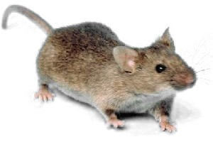

Humanized Transgenic Berkeley (BERK) Mice Expressing Human Sickle Hemoglobin Recapitulate Many Features of SCD & complex pain
Hba^{tm1Paz} Hbb^{tm1Tow} Tg(HBA-HBBs)41Paz/J
Homozygous mice express >99% human sickle hemoglobin
  Homozygous knockout of murine alpha- and beta-globin
  Transgenic expression of human alpha- and beta sickle-globin (HbSS-sickle mice)
  Transgenic expression of normal human HbA (HbAA-control mice)
  (Paszty et al., Science 1997)
Express many hematological and pathological features of SCD
Develop chronic mechanical, thermal and musculoskeletal hyperalgesia at 3.0-3.5 months of age (Kohli et al., Blood 2010)

Slide 22
Improved Dietary Components in Sickle Diet
 |  | Rodent Diet | Sickle Diet
Minerals | Magnesium | 0.2% | 0.48%
 | Zinc | 70 ppm | 225 ppm
 | Copper | 15 ppm | 30 ppm
Amino Acids | Arginine | 1% | 2.52%
 | Cystine | 0.4% | 0.7%
 | Aspartic Acid | 1.4% | 2.53%
 | Glutamic Acid | 3.4% | 5.16%
 |  | Rodent Diet | Sickle Diet
Vitamins | Vitamin A | 15 IU/g | 33 IU/g
 | Vitamin E | 110 IU/g | 200 IU/g
 | Folate | 4ppm | 8ppm
 | Vitamin B-12 | 0.08 mcg/kg | 60 mcg/kg
Fatty Acids | Omega-3 fatty acids | 0% | 0.26%
Energy density |  | Protein: 24% Fat: 18% | Protein: 27.5% Fat: 26%
Notes:
Between the two types of diet, there are differences in the nutrious components, such as zinc, arginine, vitamin B-12 and omega-3 fatty acid.

Slide 23
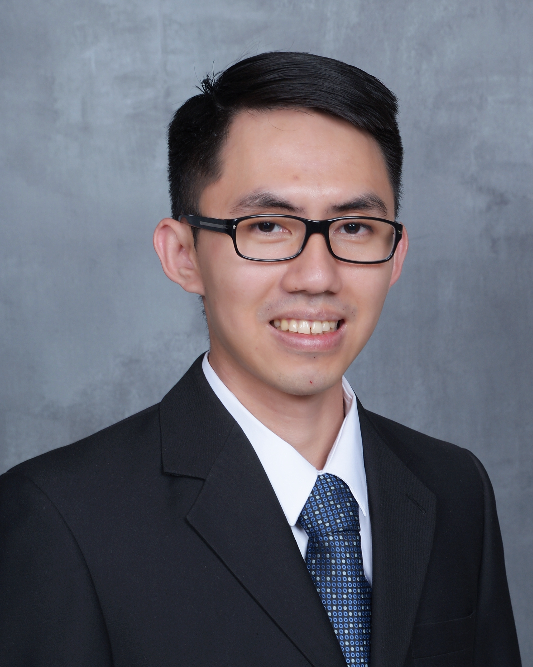
Diet and Comfort modulate pain in sickle mice
Tran H, Sagi V, Jarrett S, Palzer EF, Badgaiyan RD, Gupta K. Sci Rep. 2021 Feb 1;11(1):2330.
Deprived | Happy
Male in isolation on Rodent Diet without companion (RD/M-) | Male on Sickle Diet with female companion [SD/M+]
 | Unhappy Withdrawal of happiness Female withdrawn leaving the male mouse alone
Dr Huy Tran
Resident
Univ Arkansas
Treatment groups: (n=10/treatment), HbSS-BERK
Notes:
We divided them into several groups. 6 groups received treaments, including 4 groups of HbSS and 2 groups of HbAA.

Slide 24
Diet and happiness reduce pain
5
10
4
8
Pain
Pain
3
6
Serotonin
Pixel Count x 10⁴
Pain
Mechanical hyperalgesia
PWF (1.0 g fiber)
2
4
0.008
0.002
1
2
0
0
Deprived
Happy
Unhappy

Slide 25
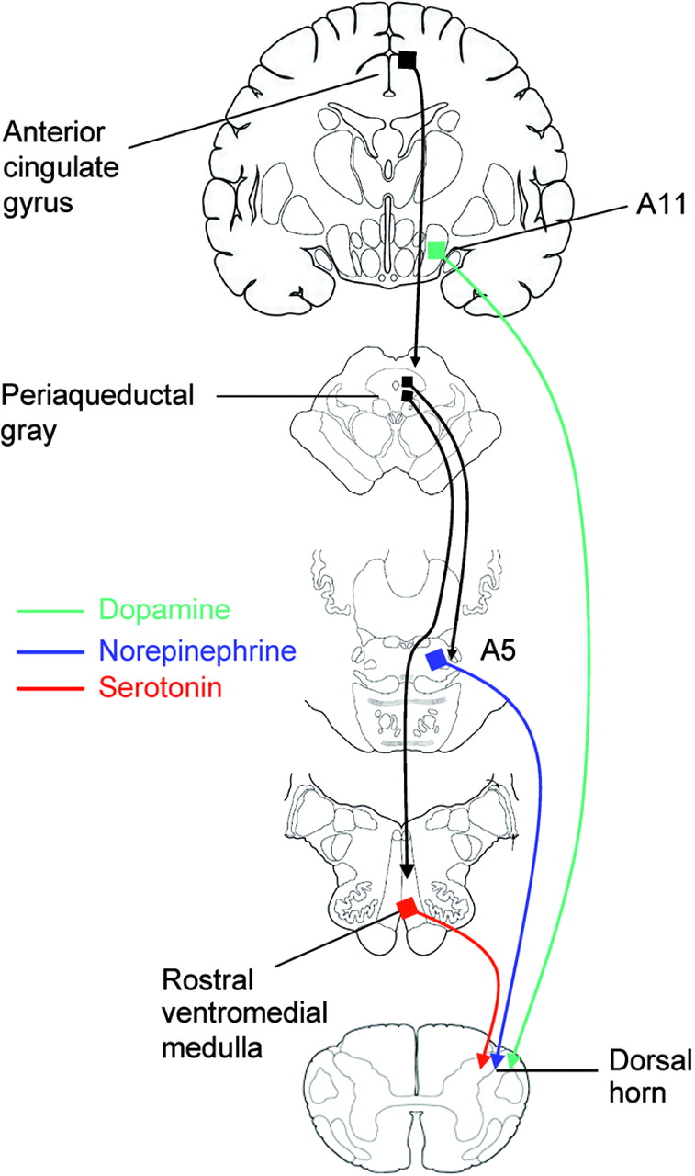
Spinothalamic mechanisms mediate pleasure-related analgesia.
Serotonergic and norepinephrinergic neurons
Dopaminergic
Caudal mesodiancephalic periaqueductal grey (PAG)
Reuptake transporter
Norepinephrinergic Ventrolateral pons
Serotonin
Duloxetine
Norepinephrine
Serotonin receptor
Norepinephrine
receptor
Serotonergic
Rostral ventromedial medulla (RVM)
First and second order nerve terminals

Slide 26
Withdrawal of pleasure diminishes spinothalamic anti-nociceptive mechanisms.
Serotonin
Dopamine
15
6
10
4
Pixel count x10³
Pixel count x10³
RVM-Brain
PAG-Brain
5
2
0
0
Deprived
Happy
Unhappy
Deprived
Happy
Unhappy
Whole
Spinal cord
pg/g spinal cord
Scaled intensity
Male HbSS-BERK; n=6
Deprived
Happy
Unhappy
Deprived
Happy
Unhappy

Slide 27
Withdrawal of high calorie diet and companion increases inflammation and splenomegaly.
Unhappy
Unhappy
~8-10 mo male HbSS BERK

Slide 28
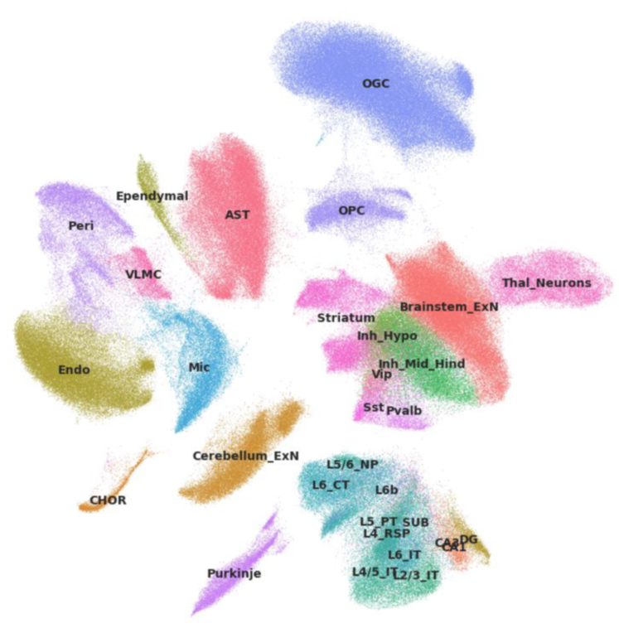
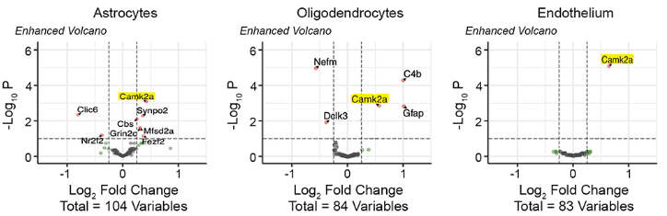
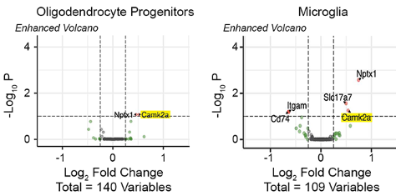

Unhappiness Leads to Cell-Specific Gene Signature Alterations in the Brain
Multiplexed Error-Robust Fluorescence In Situ Hybridization
(MERFISH)
Donovan Argueta, PhD
NCCIH K99 Trainee
Coll: Xiangmin Xu, PhD
Notes:
Change Camk2a in red text in the table

Slide 29
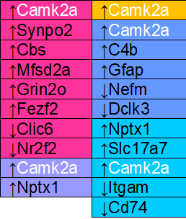
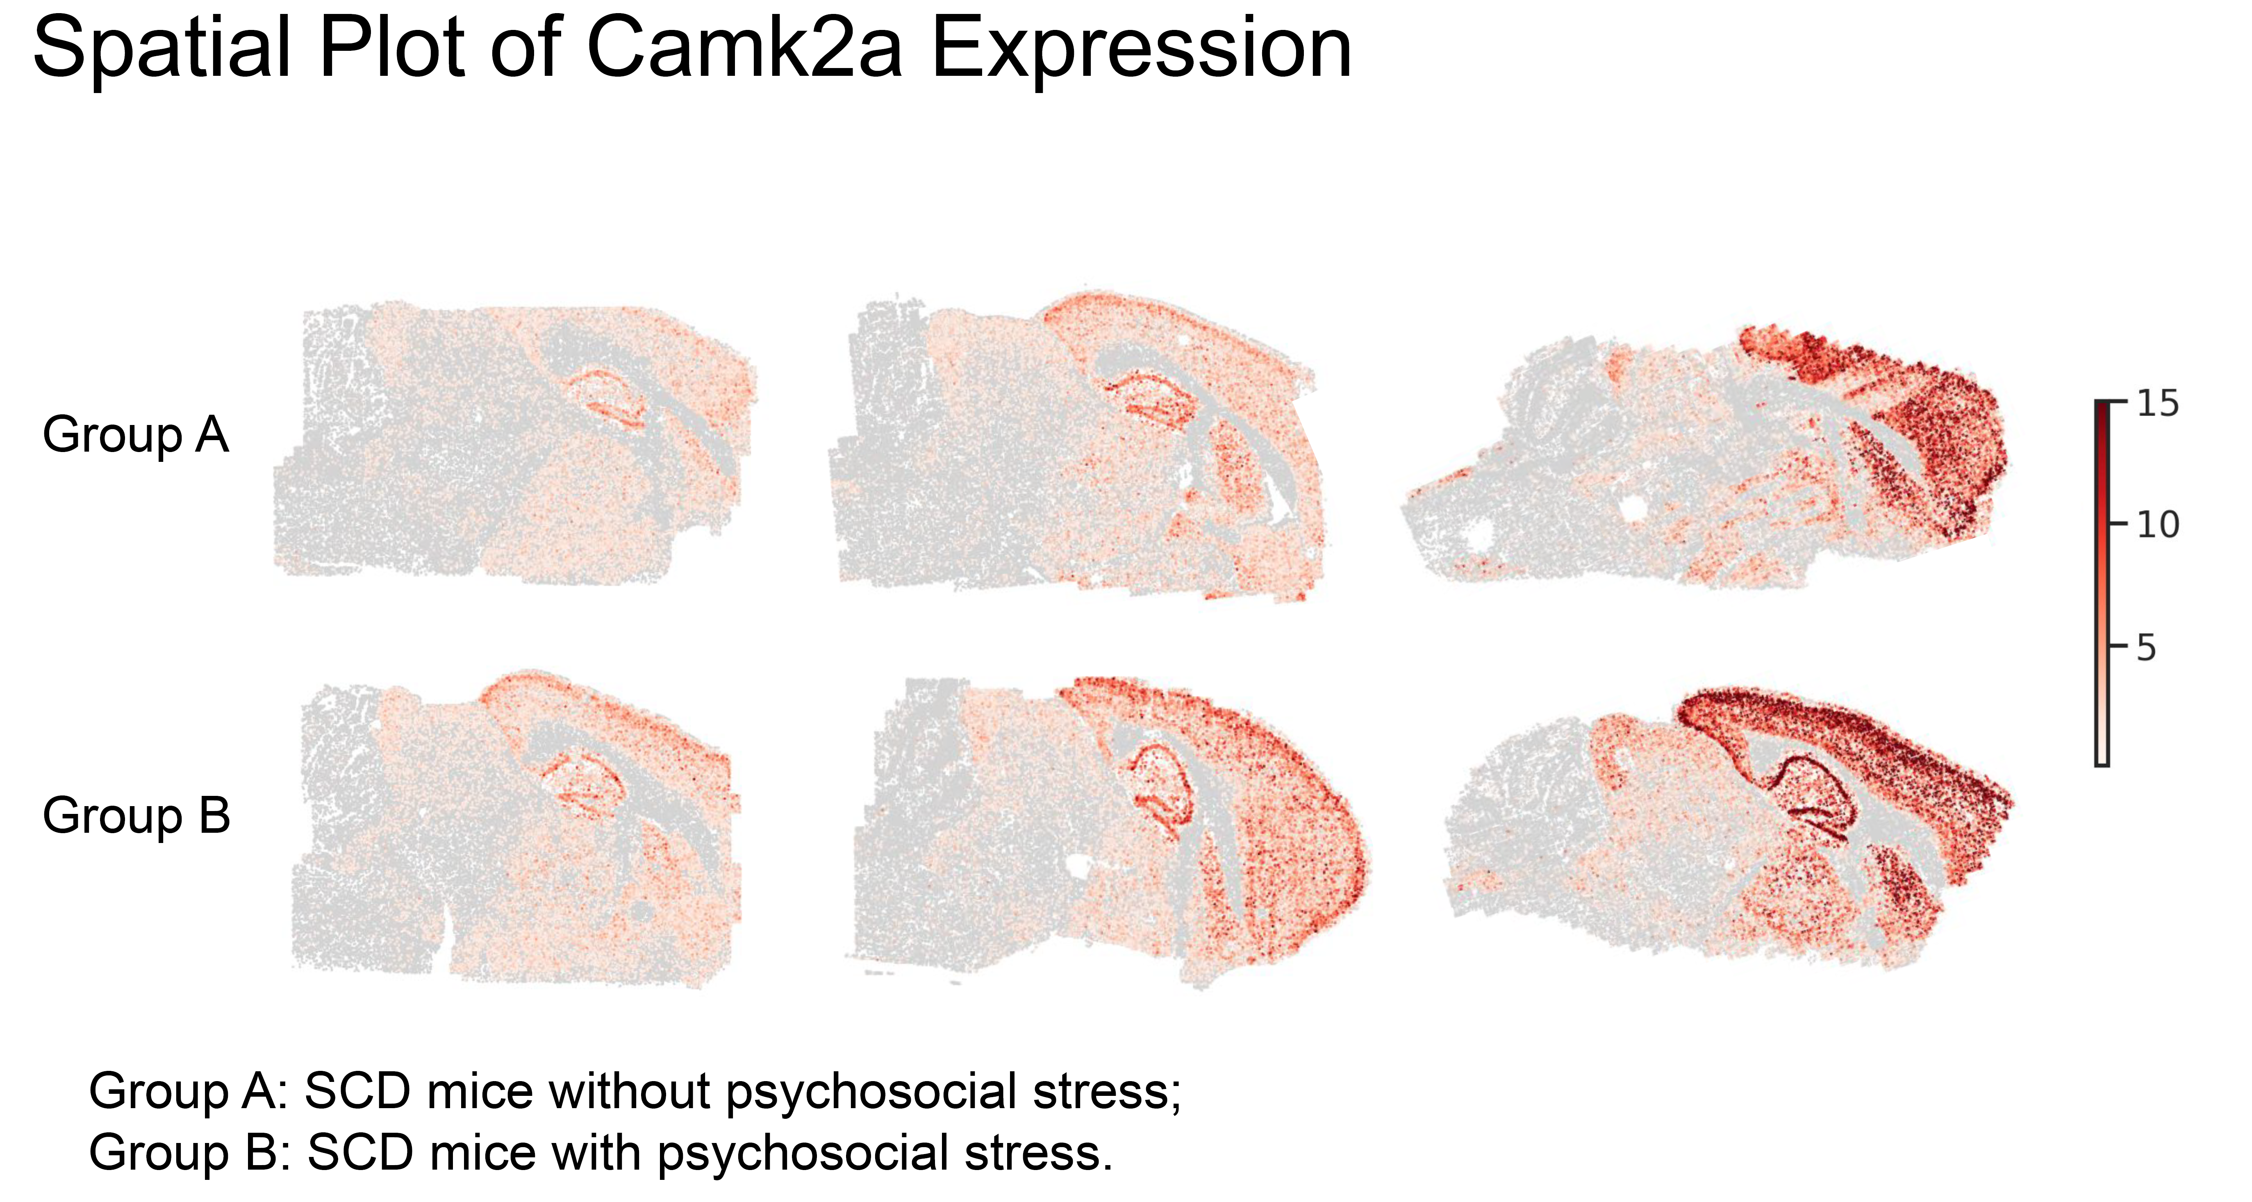
Unhappiness Induces CaMKIIα Expression in Cortical and Hippocampal Regions Involved in Pain and Cognition
Happy
Cell Type | Fold-Change Isolation | P-Value
Endothelium | X1.560 | <0.001
Astrocytes | X1.344 | 0.001
Oligodendrocytes | X1.477 | 0.001
Oligo Progenitor | X1.431 | 0.084
Microglia | X1.453 | 0.056
SSc
CR
HP
CaMKIIα expression (A.U.)
Unhappy
SSc
CR
HP
CaMKIIα/Camk2a, calmodulin kinase 2 alpha; CR, cerebellum; HP, hippocampus; SSc, somatosensory cortex.
Notes:
Separate brain images – add abbreviations for brain regions and label in italics – visibly
. Describe somatosensory cortex, hippocampus, cerebellum, etc.

Slide 30
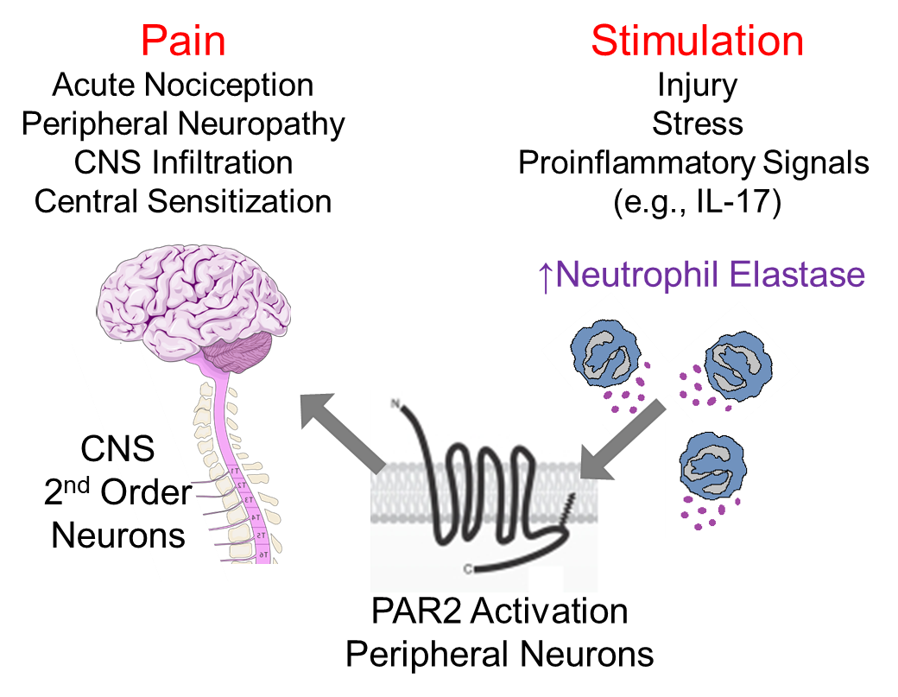
Unhappiness Exacerbates Neutrophil Activity in the Periphery and the Central Nervous System (Spinal) Simultaneously
Plasma
Spinal Cord
Elastase Activity
(mU/0.1 mL plasma)
Elastase Activity
(mU/mg protein)
HbSS-unhappy
HbSS-Companionship
Female HbSS-BERK Sickle mice, Age: ~8-10 mos, Mean ± SEM. Student’s Two-tailed T-test. *P<0.05.
Relative [Cytokine] expressed as fold change vs Isolation.
(Vicuna et al., 2015 Nat Med)

Slide 31
Curcumin
CBD
Cannabis
Cromolyn
PEA
W3 fatty acid
CBT
Diet Environment
Companion
Acupuncture
CoQ10
VR, music
INTEROCEPTION
Top-down, affective mechanisms
T
Pain
Stress
Dopaminergic
Caudal mesodiancephalic periaqueductal grey (PAG)
IL6
BBB compromised
Curcumin
CBT
Acupuncture
PEA
Diet, environment
Companionship
VR, music
VOC
T
Stroke
P-selectin
ER stress
Activated EC
Leukocyte Activation
Norepinephrinergic Ventrolateral pons
Serotonergic
Rostral ventromedial medulla (RVM)
Nitric oxide
Activated Mast Cell
Heme
CurcuminCBD
Cromolyn
Imatinib
PEA
T
Central sensitization
Antidromic release
Peripheral sensitization

Slide 32
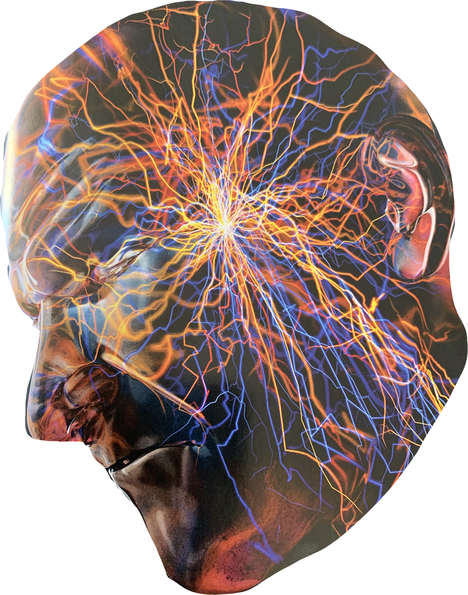
Which integrative intervention to chose?
Curcumin
CBD
Cannabis
Cromolyn
PEA
CoQ10
W3 fatty acid
xxxx
CBT
Diet
Companion
Acupuncture
Virtual reality
Sleep
Music therapy
Environment
yyyy
?
?
?
Healthy lifestyle
Diet, hydration
Comfort
Sleep
Clean air

Slide 33
ACKNOWLEDGEMENTS
Human subjects in trials
Lab Members
Donovan A Argueta, PhD
Yugal Goel, PhD
Hemanth Cherukury, PhD
Stacy Kiven
Varun Sagi, MD
Jianxun Lei, PhD
Ying Wang, MD, PhD
Divyanshoo Kohli, MD
Lucile Vincent, PhD
Raghda T Fouda, MD, PhD
Jinny A Paul, PhD
Yessenia V Guevara, PhD
Yann Lamarre, PhD
Joe Cataldo, PhD
Lab Members
Huy Tran, DO
Julia Nguyen
Waogwende L Song-Naba, MD Anupam Aich, PhD
Om Jahagirdar
Aditya Mittal
Kristen Peterson
Kendall O’Daniel
Carolina Mireles
Reina Lomelli
Natalie Garcia
Megan Uhelski, PhD
Collaborators
Xiangmin Xu, PhD
Sergei Nekhai, PhD
Robert P Hebbel, MD
Bin He, PhD
Raj Badgayan, MD
Donald A Simone, PhD
Kimberlei Richardson, PhD
Hassan Brim, PhD
Anindya Bagchi, PhD
Joni Ricks-Odie, PhD
U24AT012868; UO1HL117664, RO1s HL6880, HL103733, CA263806; HL68802-06S1; HL68802-7S1
NCCIH Supplement; Susan Samueli Scholar Award; UCI Foundation

Slide 34
Thank You!
धन्यवाद
Shukraan! ありがとうございました!
謝謝 teşekkür ederim
Dank je! ඔබට ස්තුතියි
Asante
תודה רבה לך Ngiyabonga
Je vous remercie!
Danke!
ua tsaug rau koj!
gracias

Slide 35
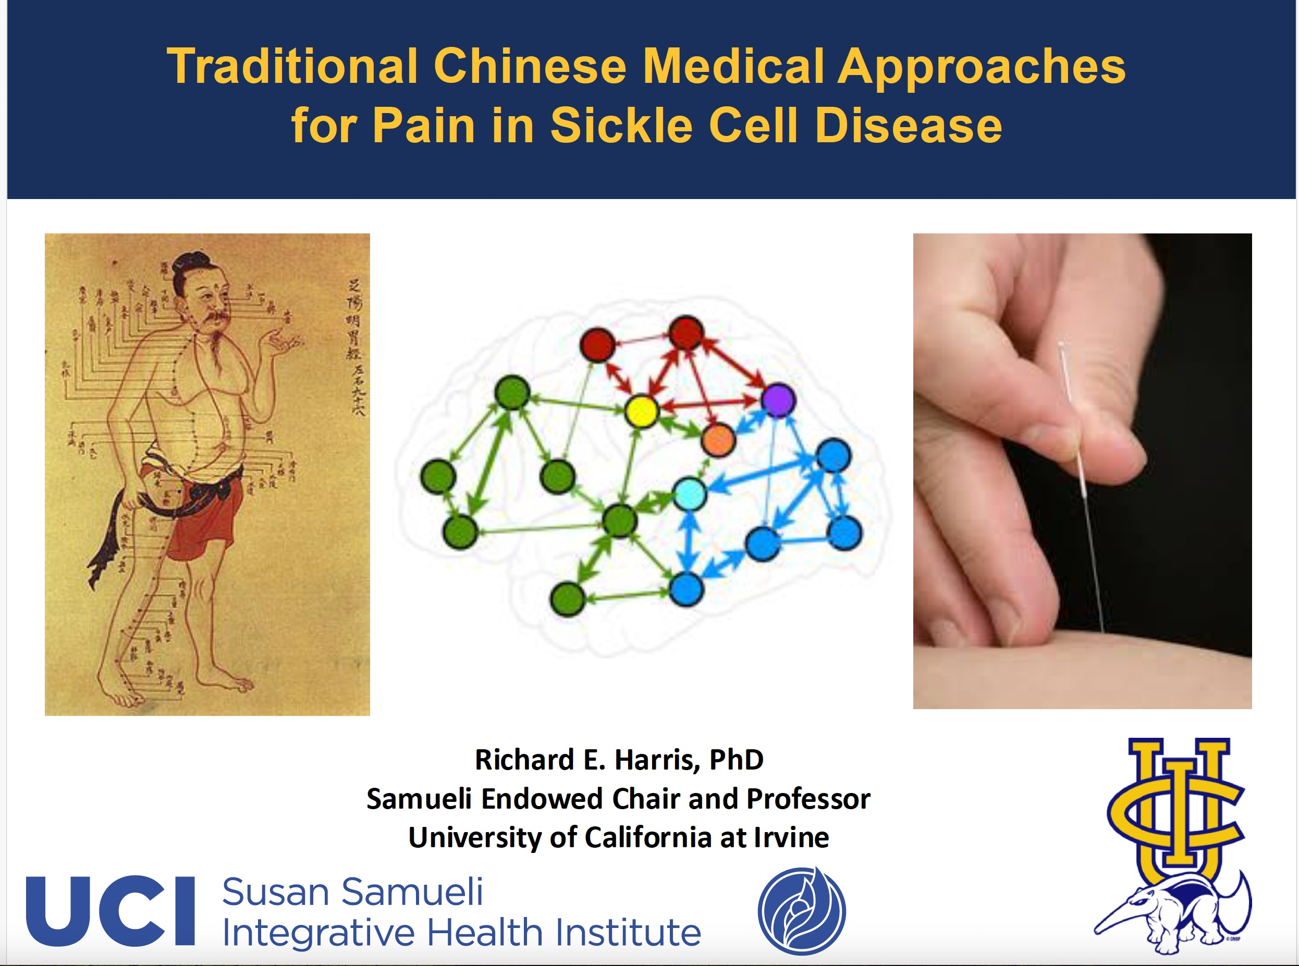

Slide 36
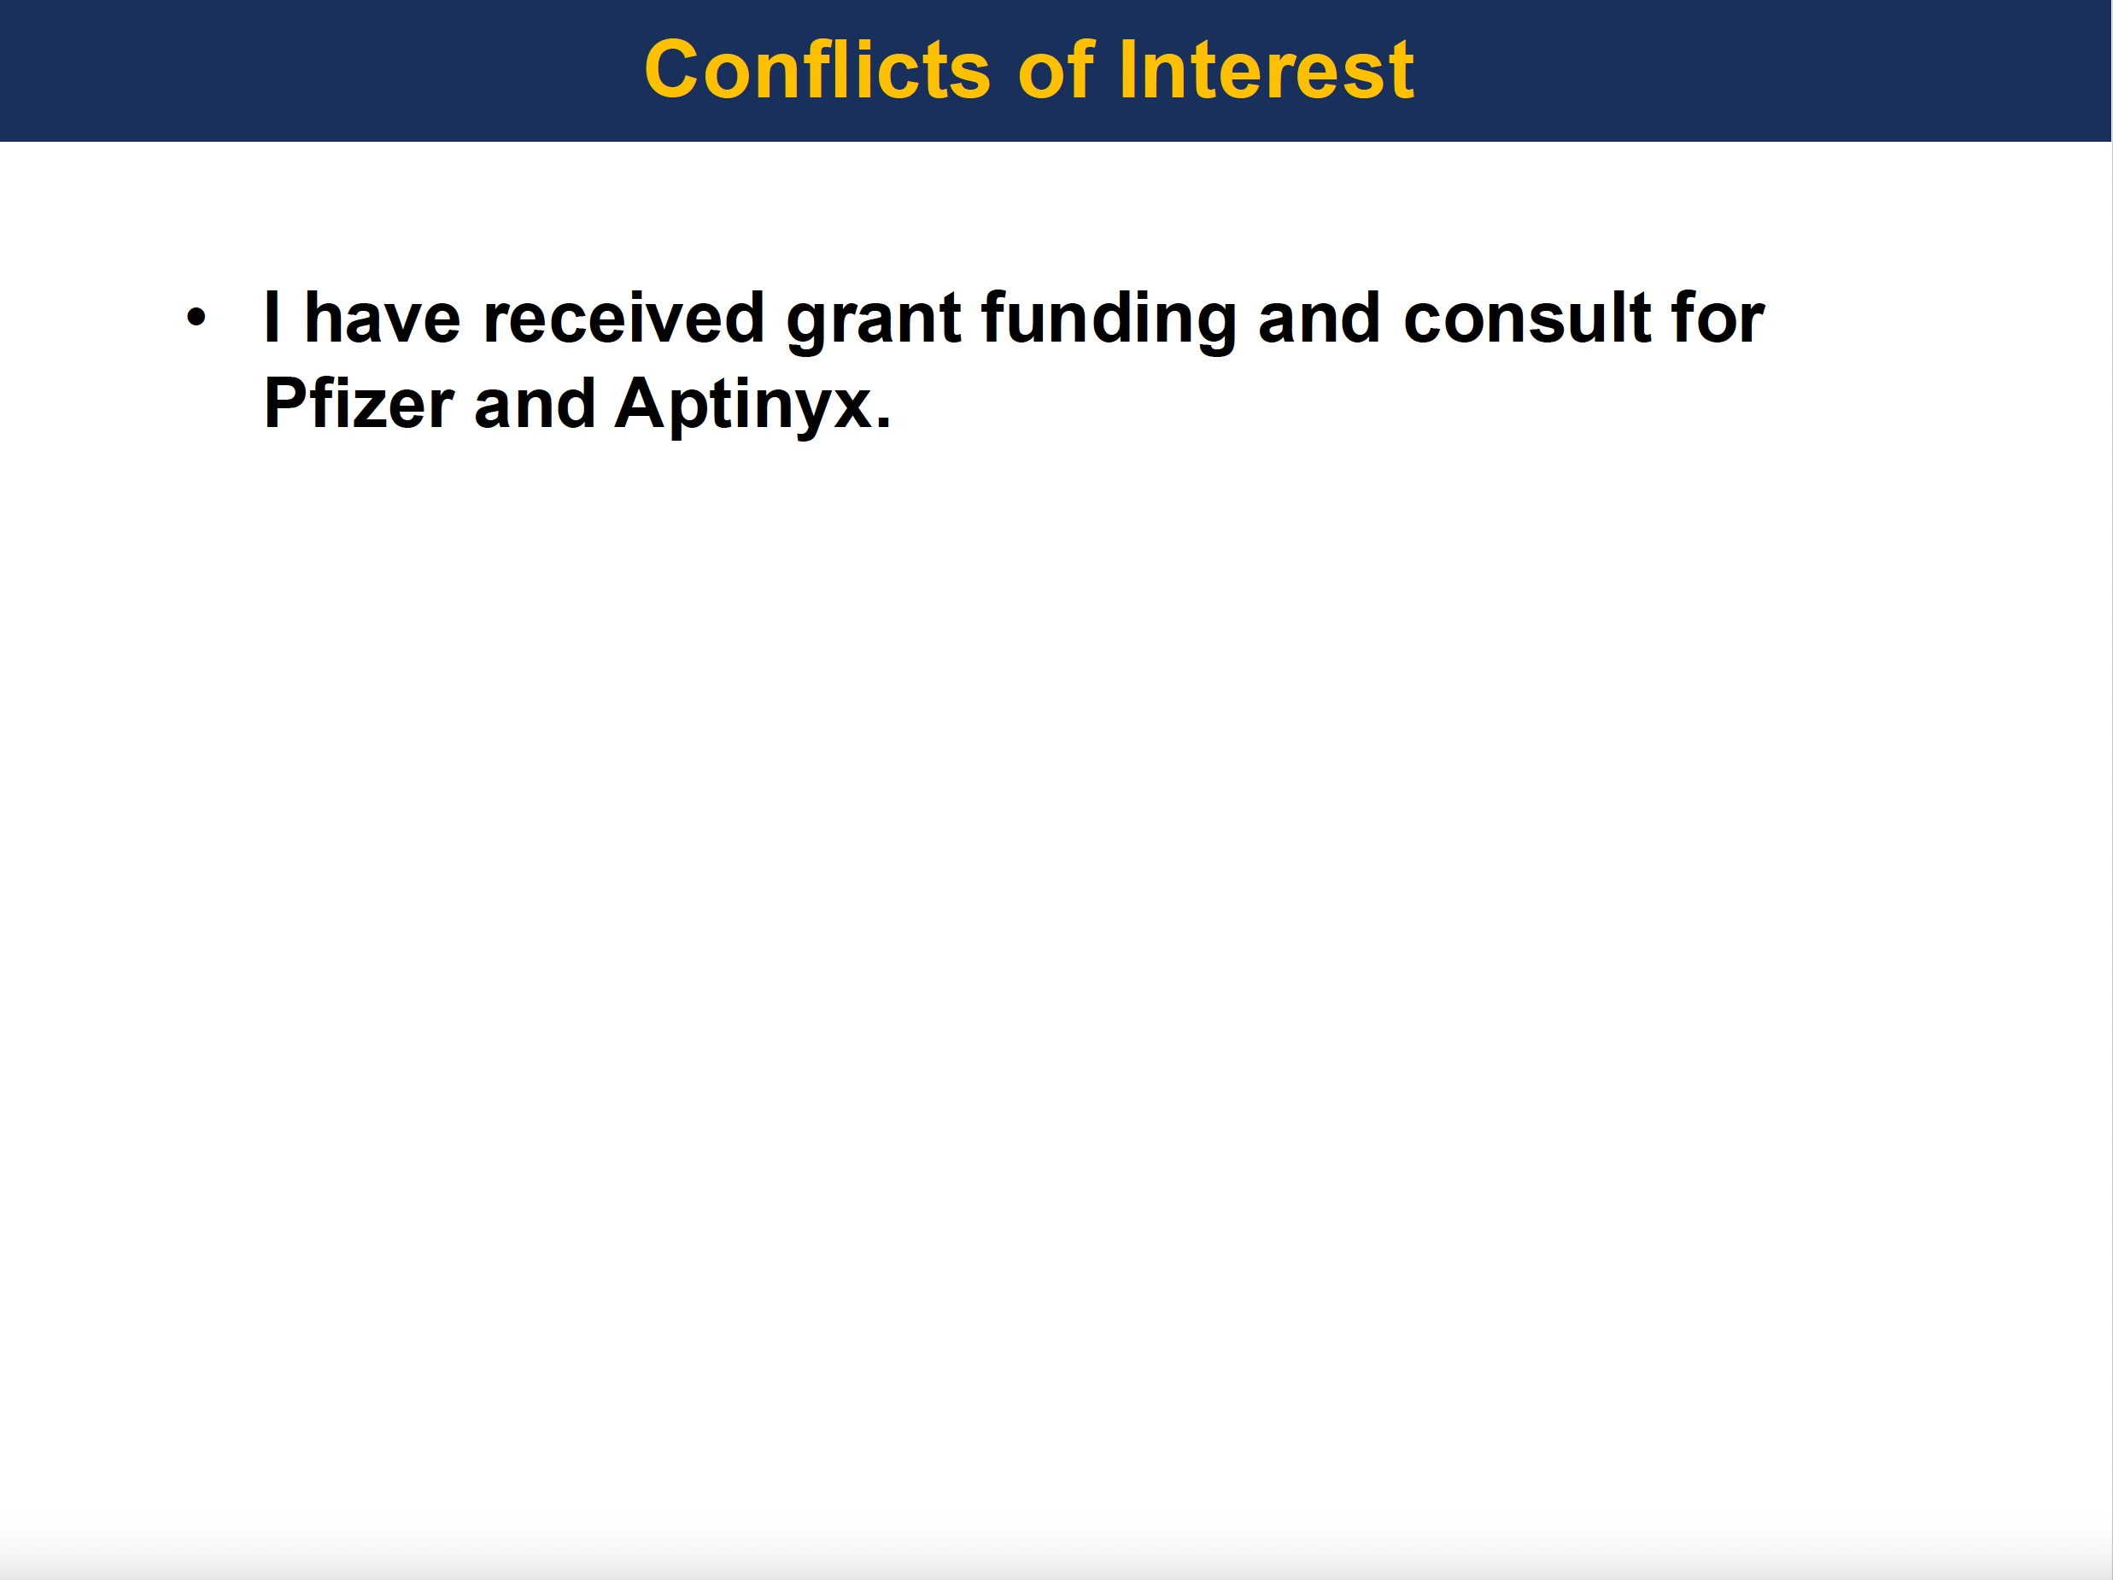

Slide 37
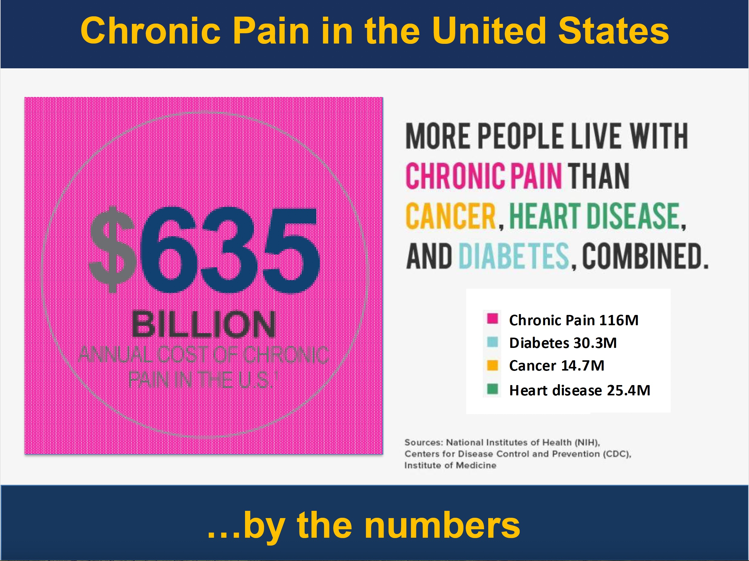

Slide 38
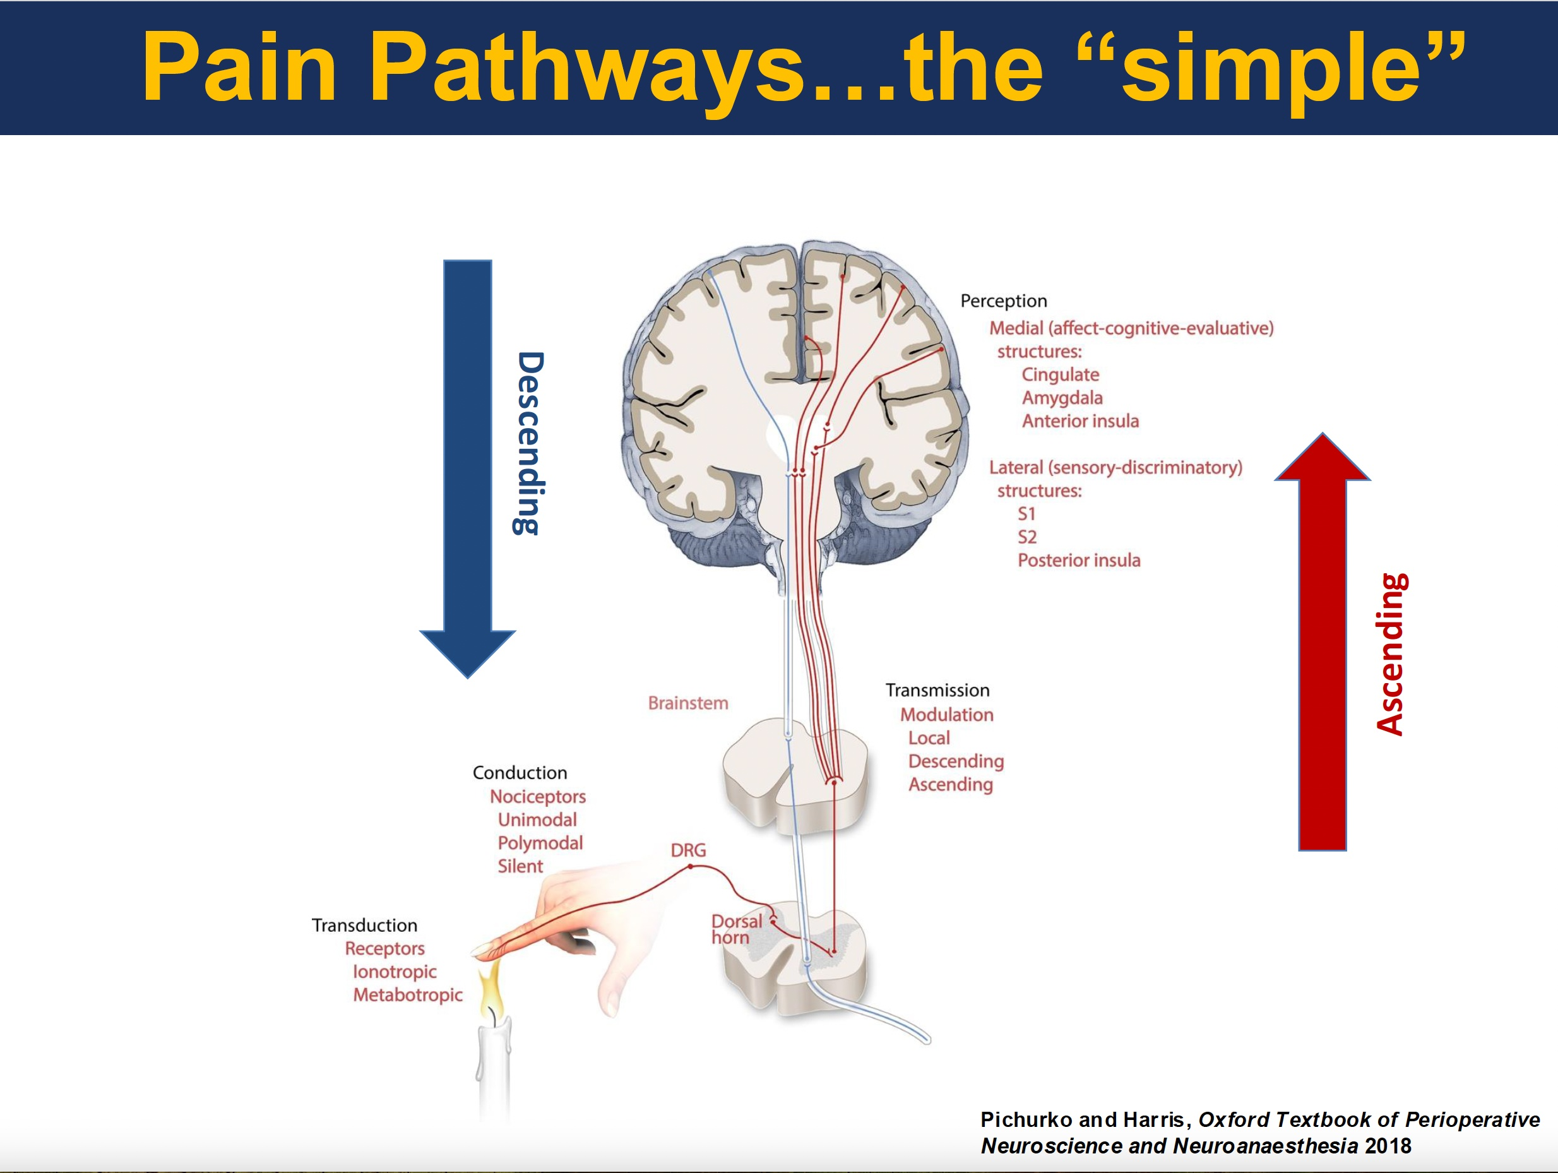

Slide 39
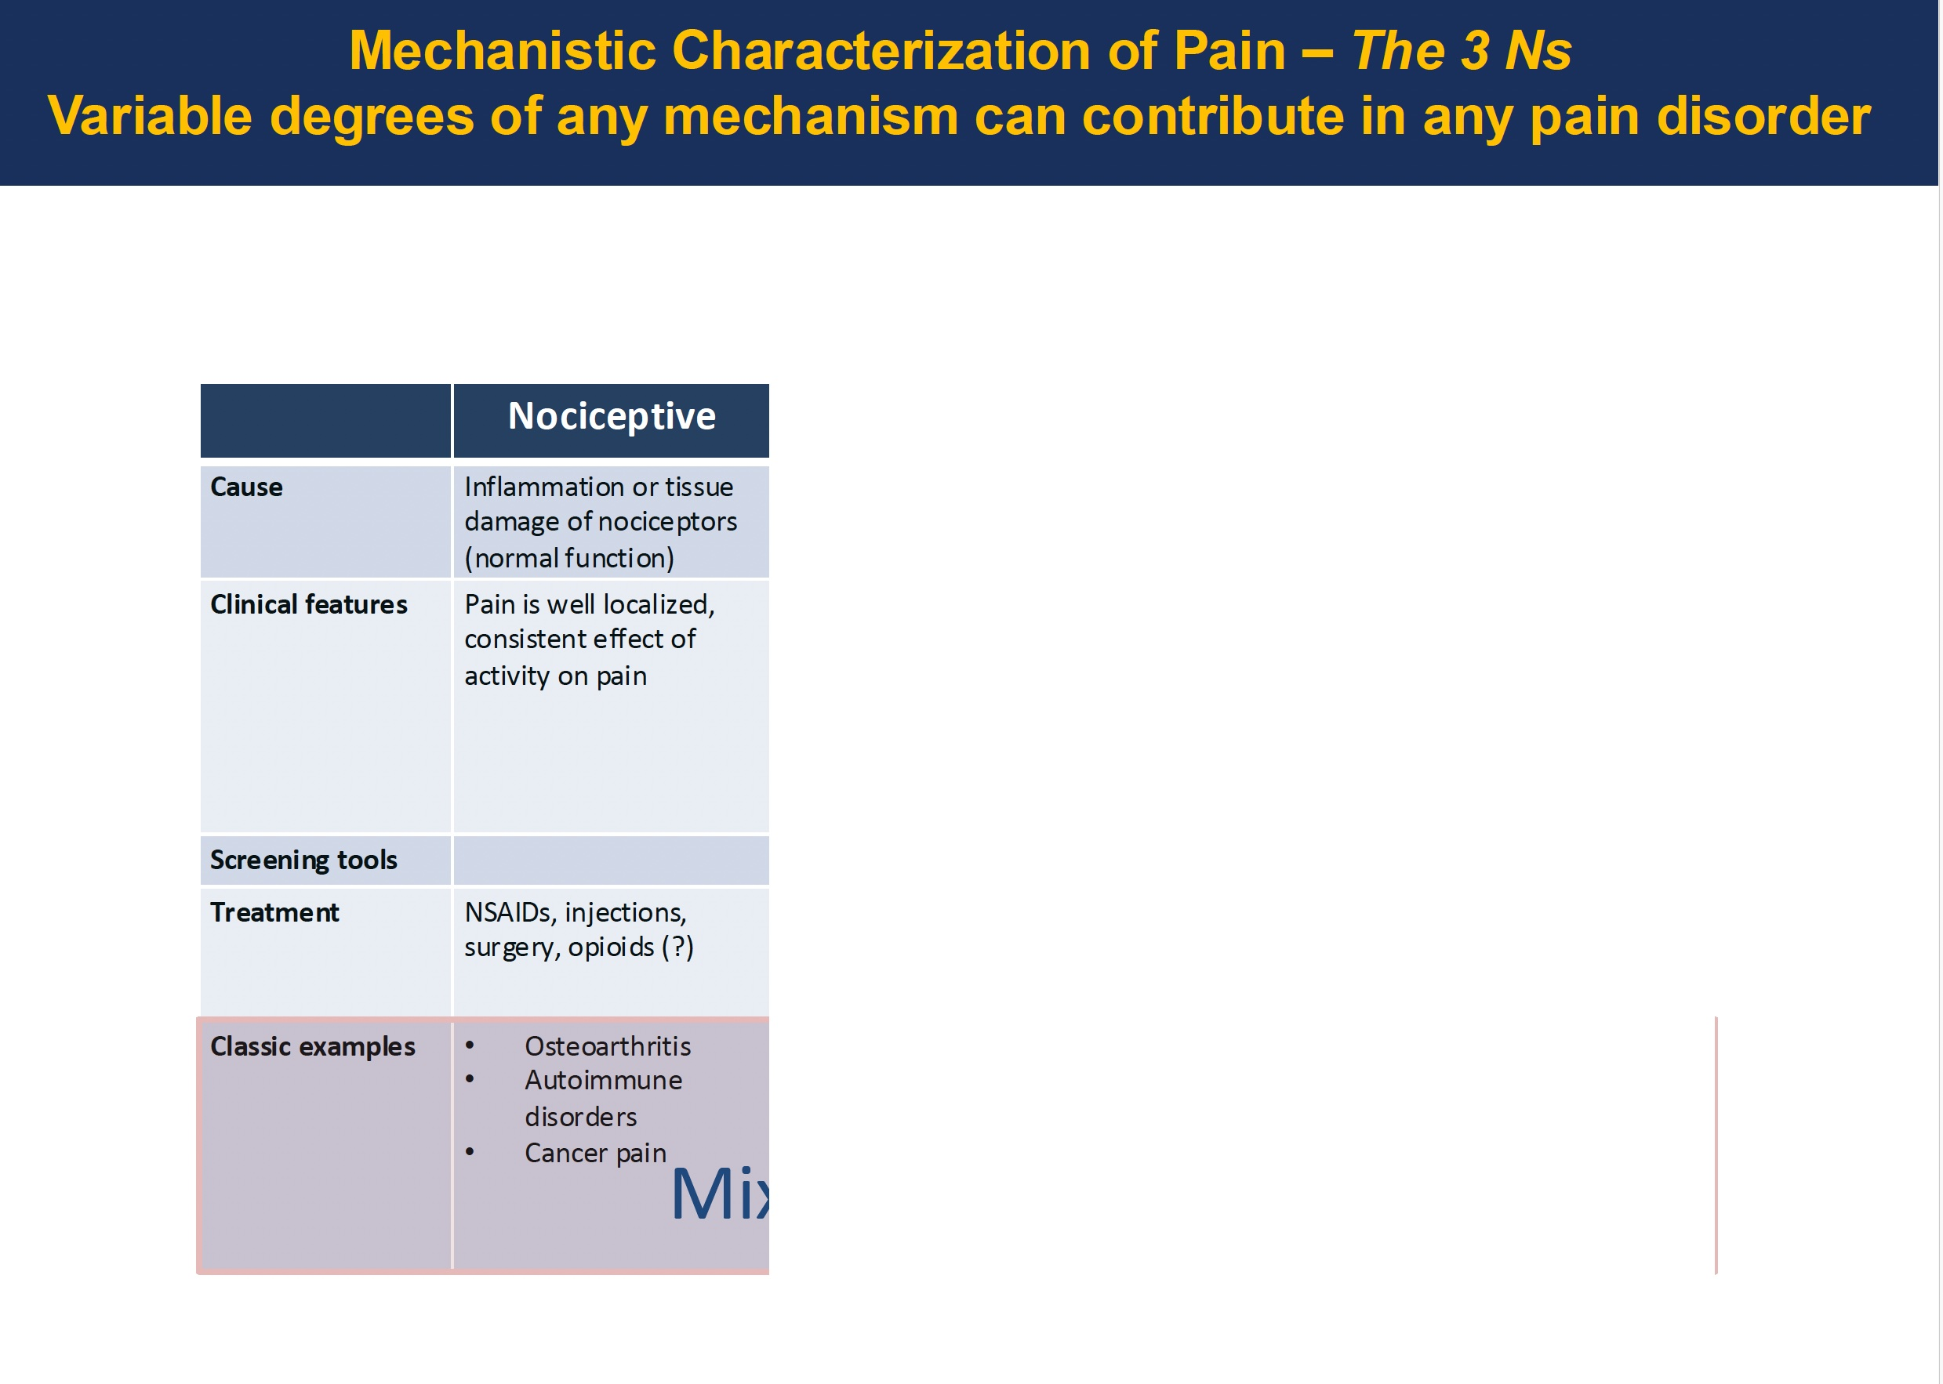

Slide 40
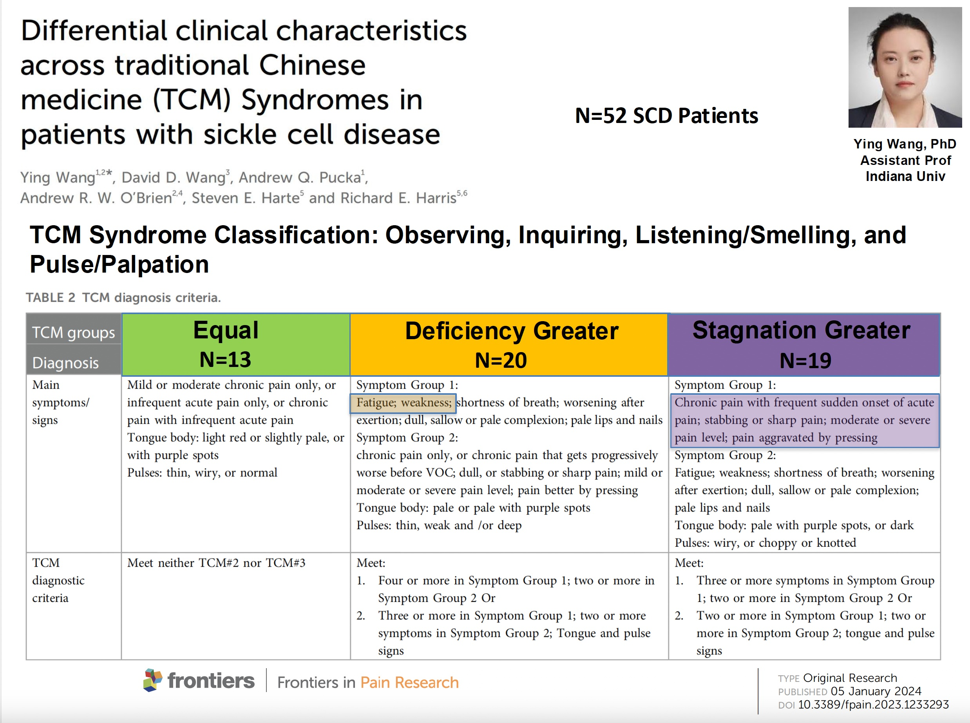

Slide 41
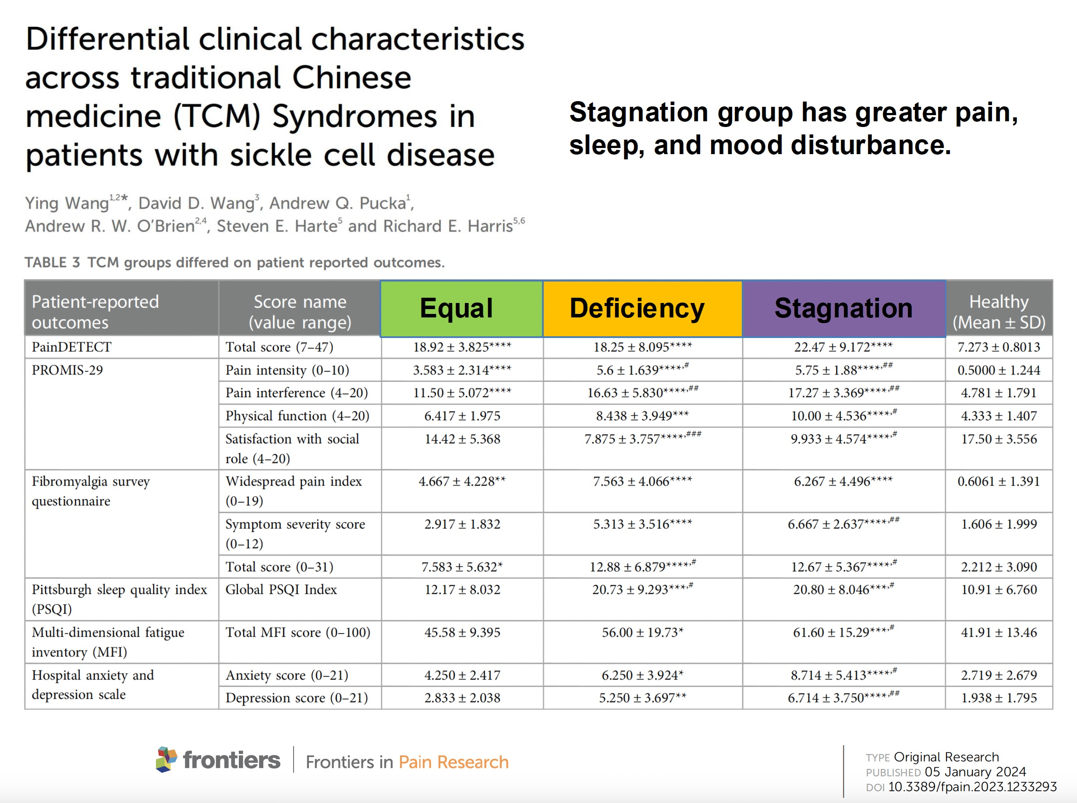

Slide 42
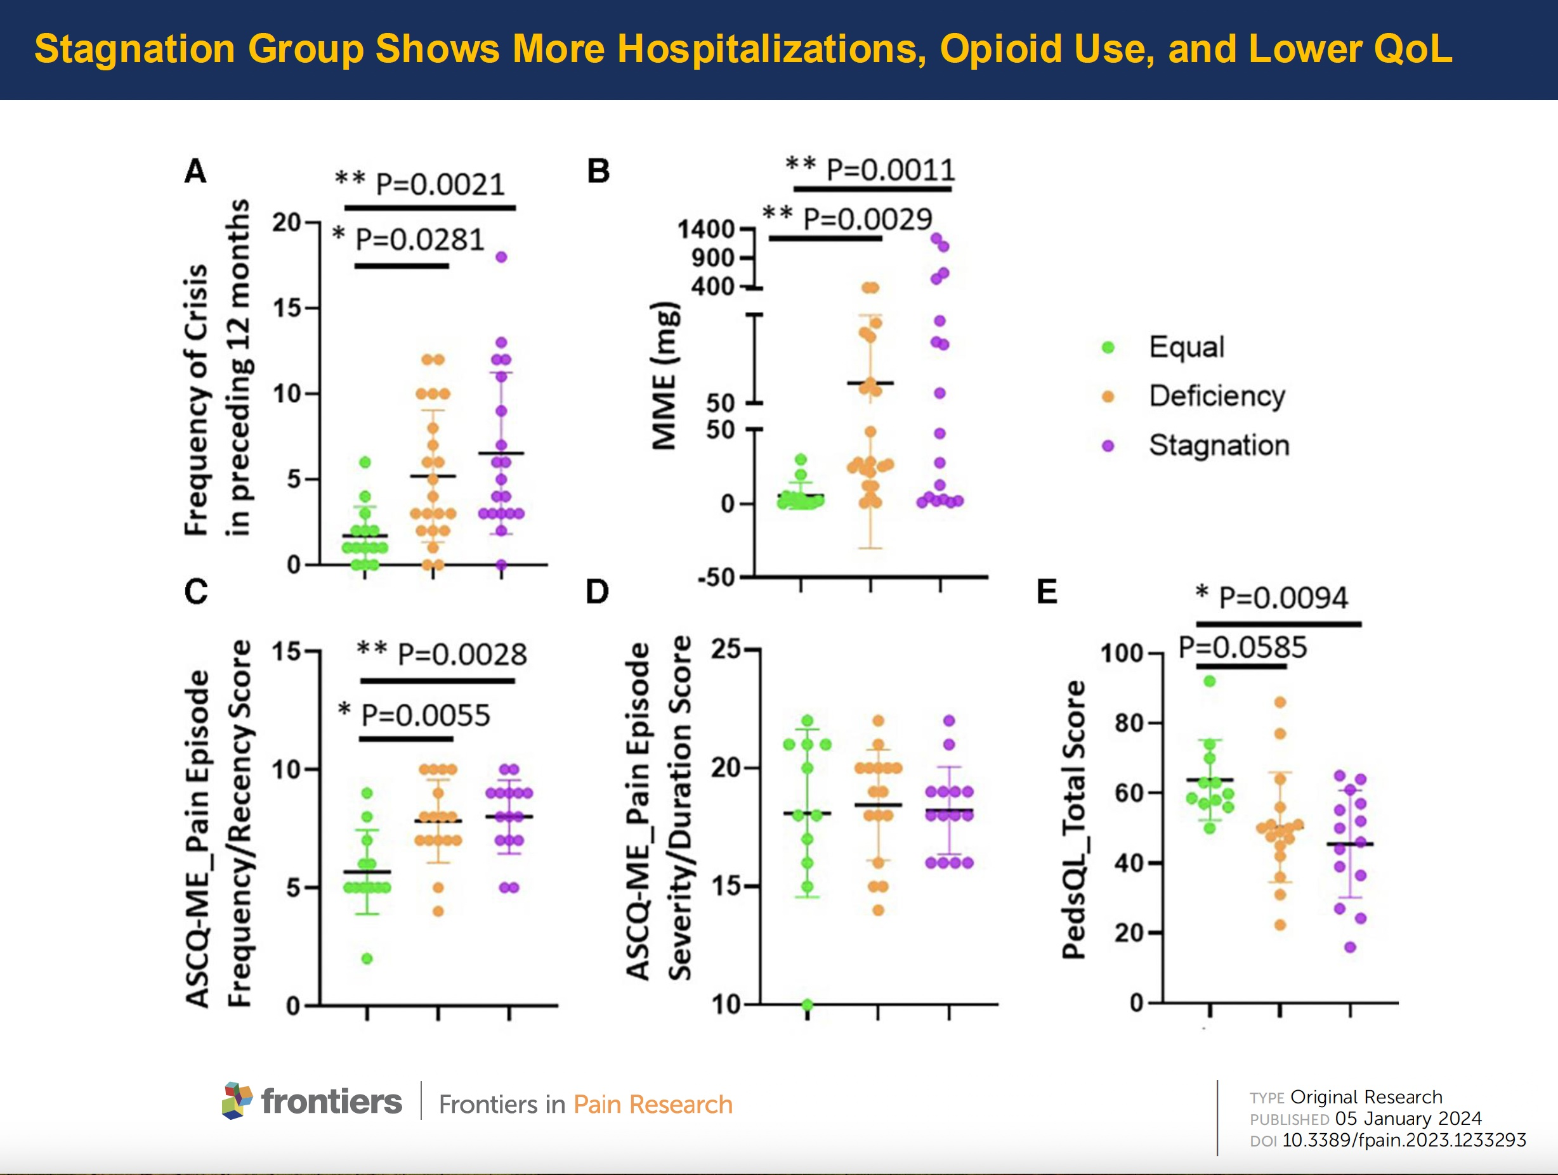

Slide 43
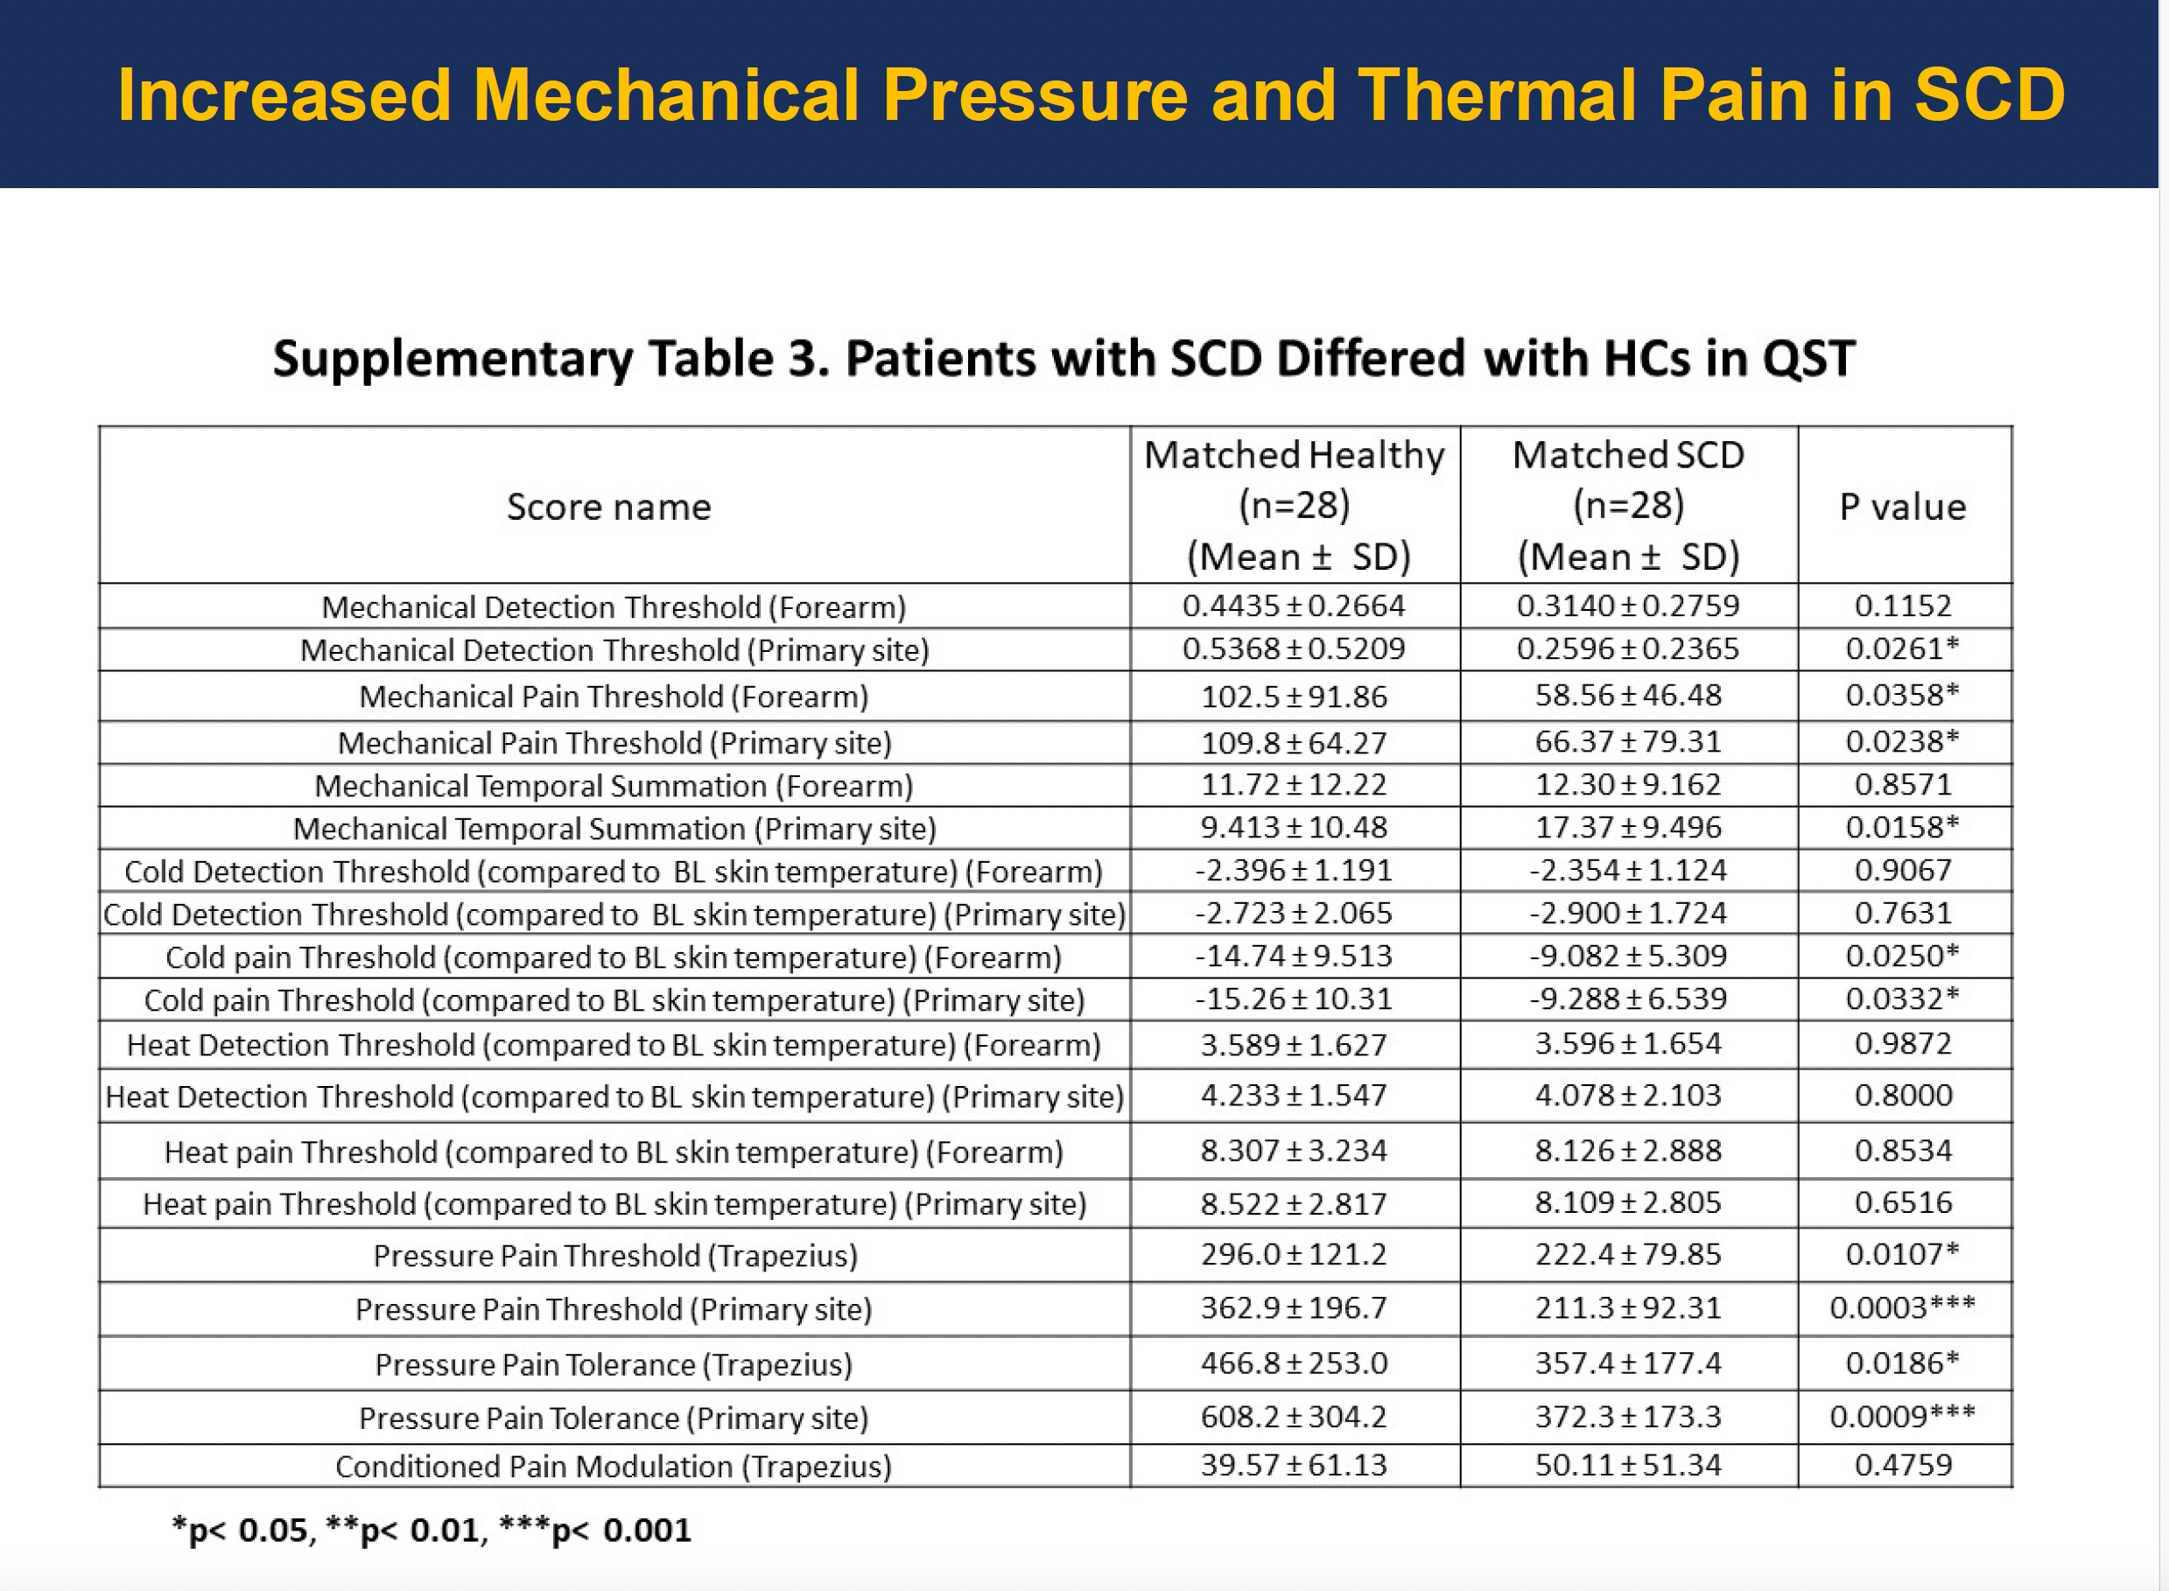

Slide 44
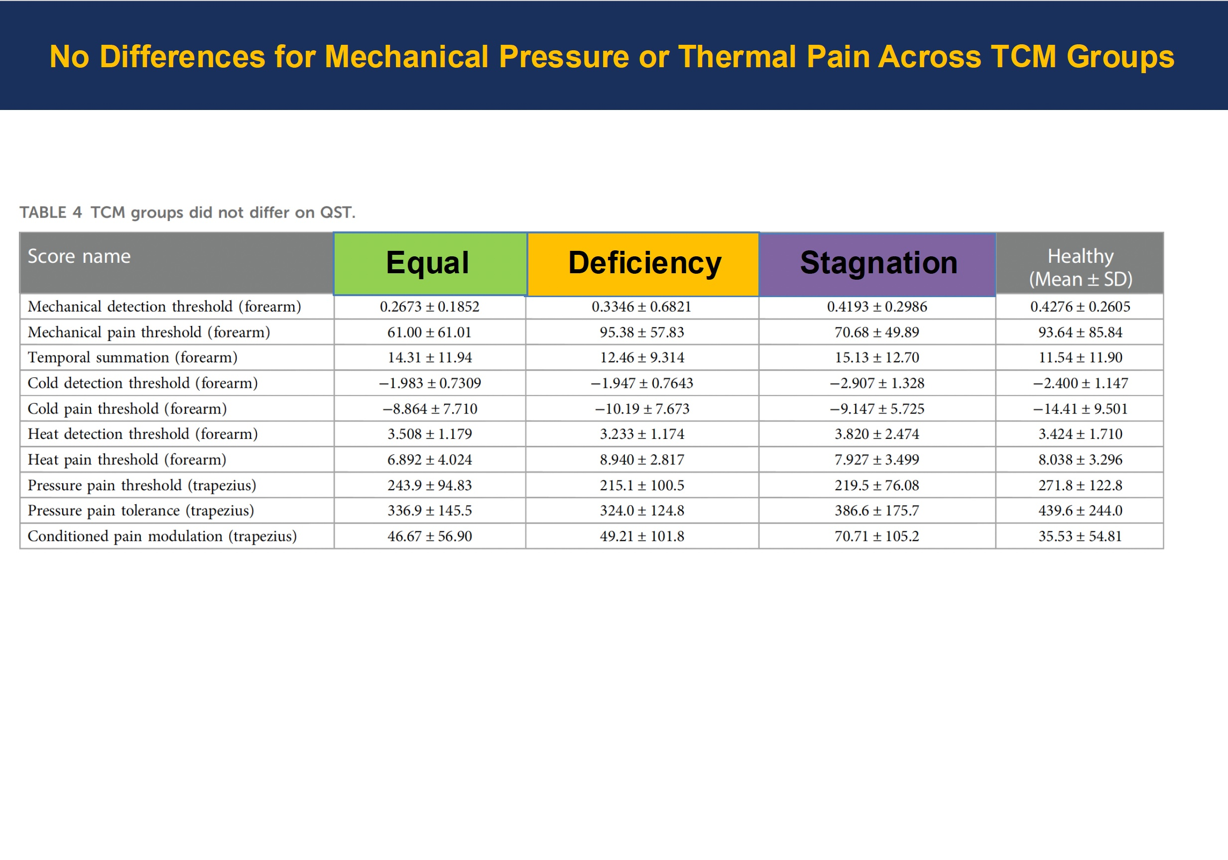

Slide 45
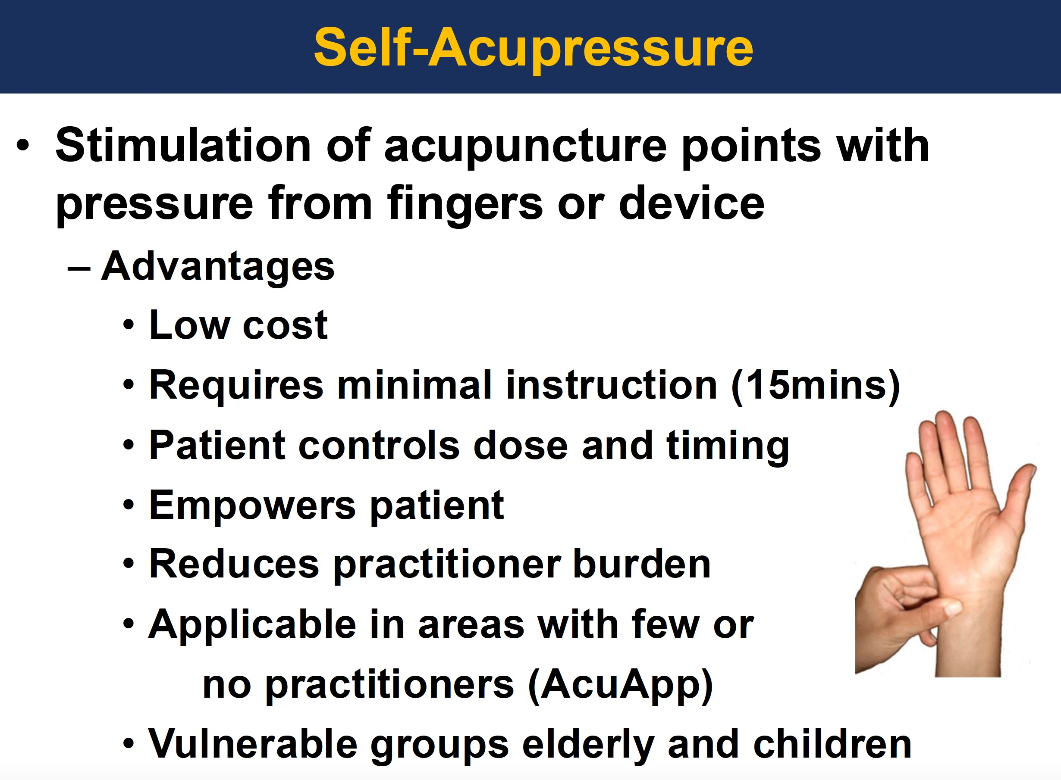

Slide 46
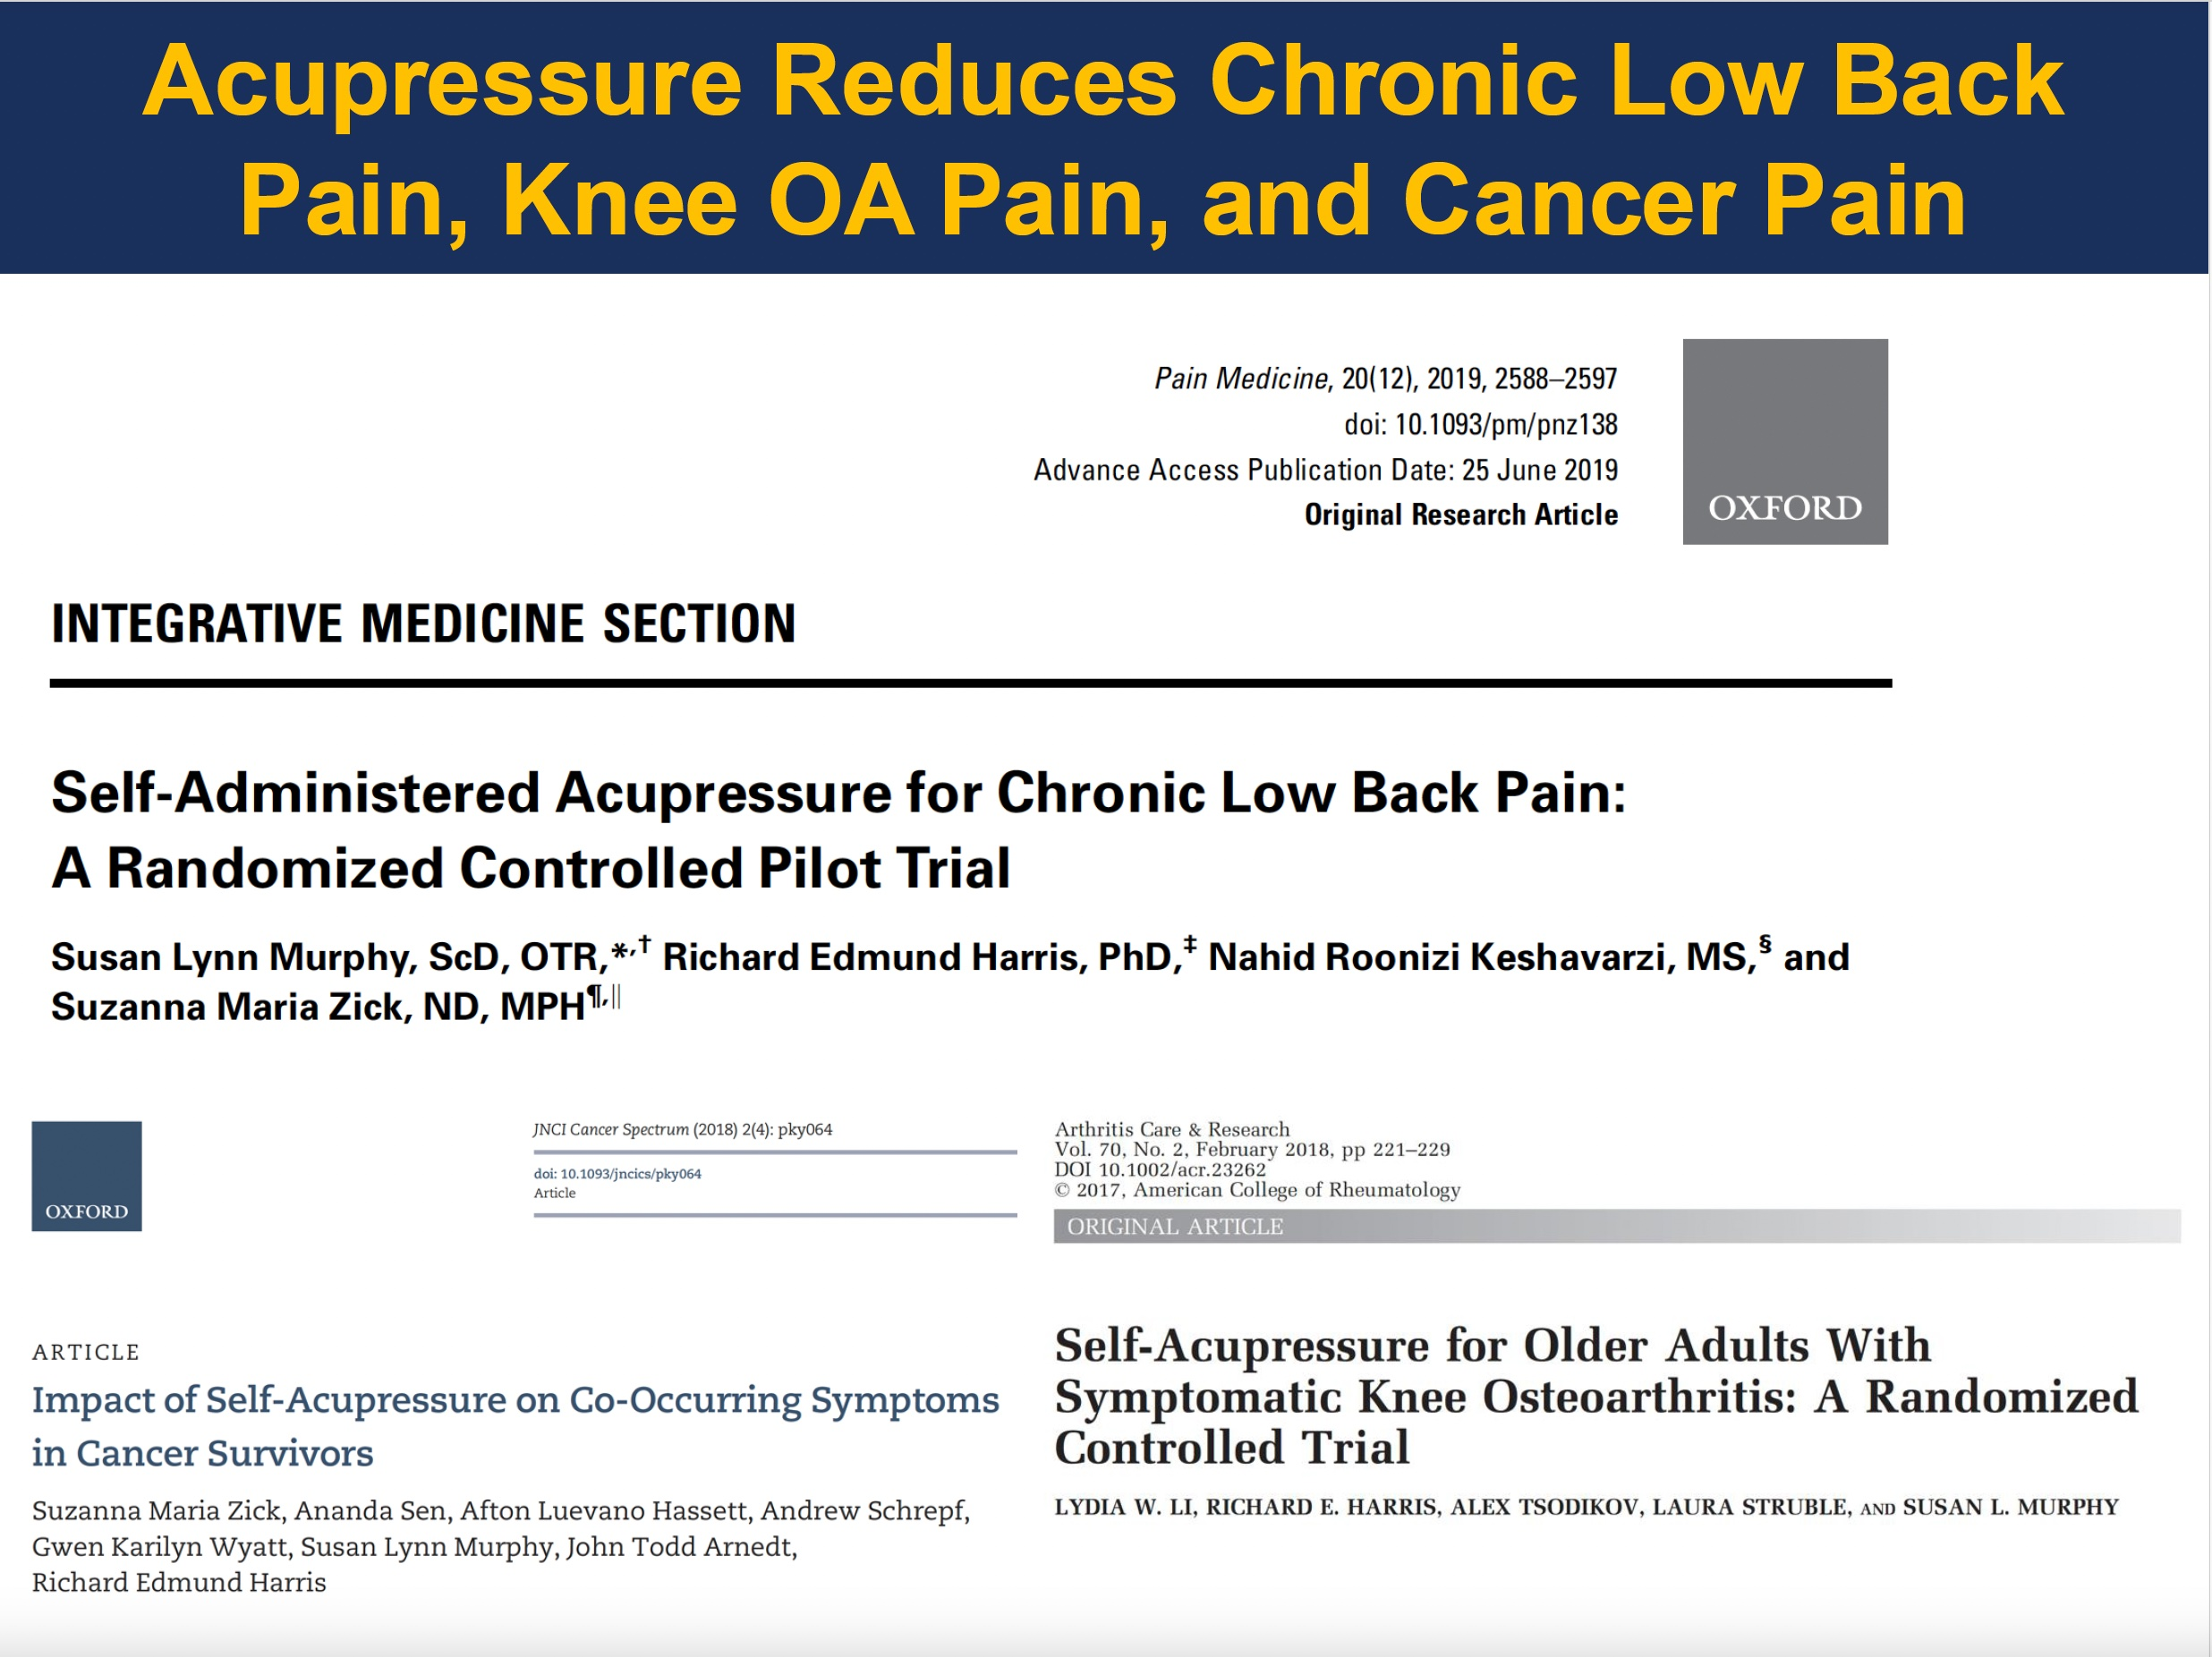

Slide 47
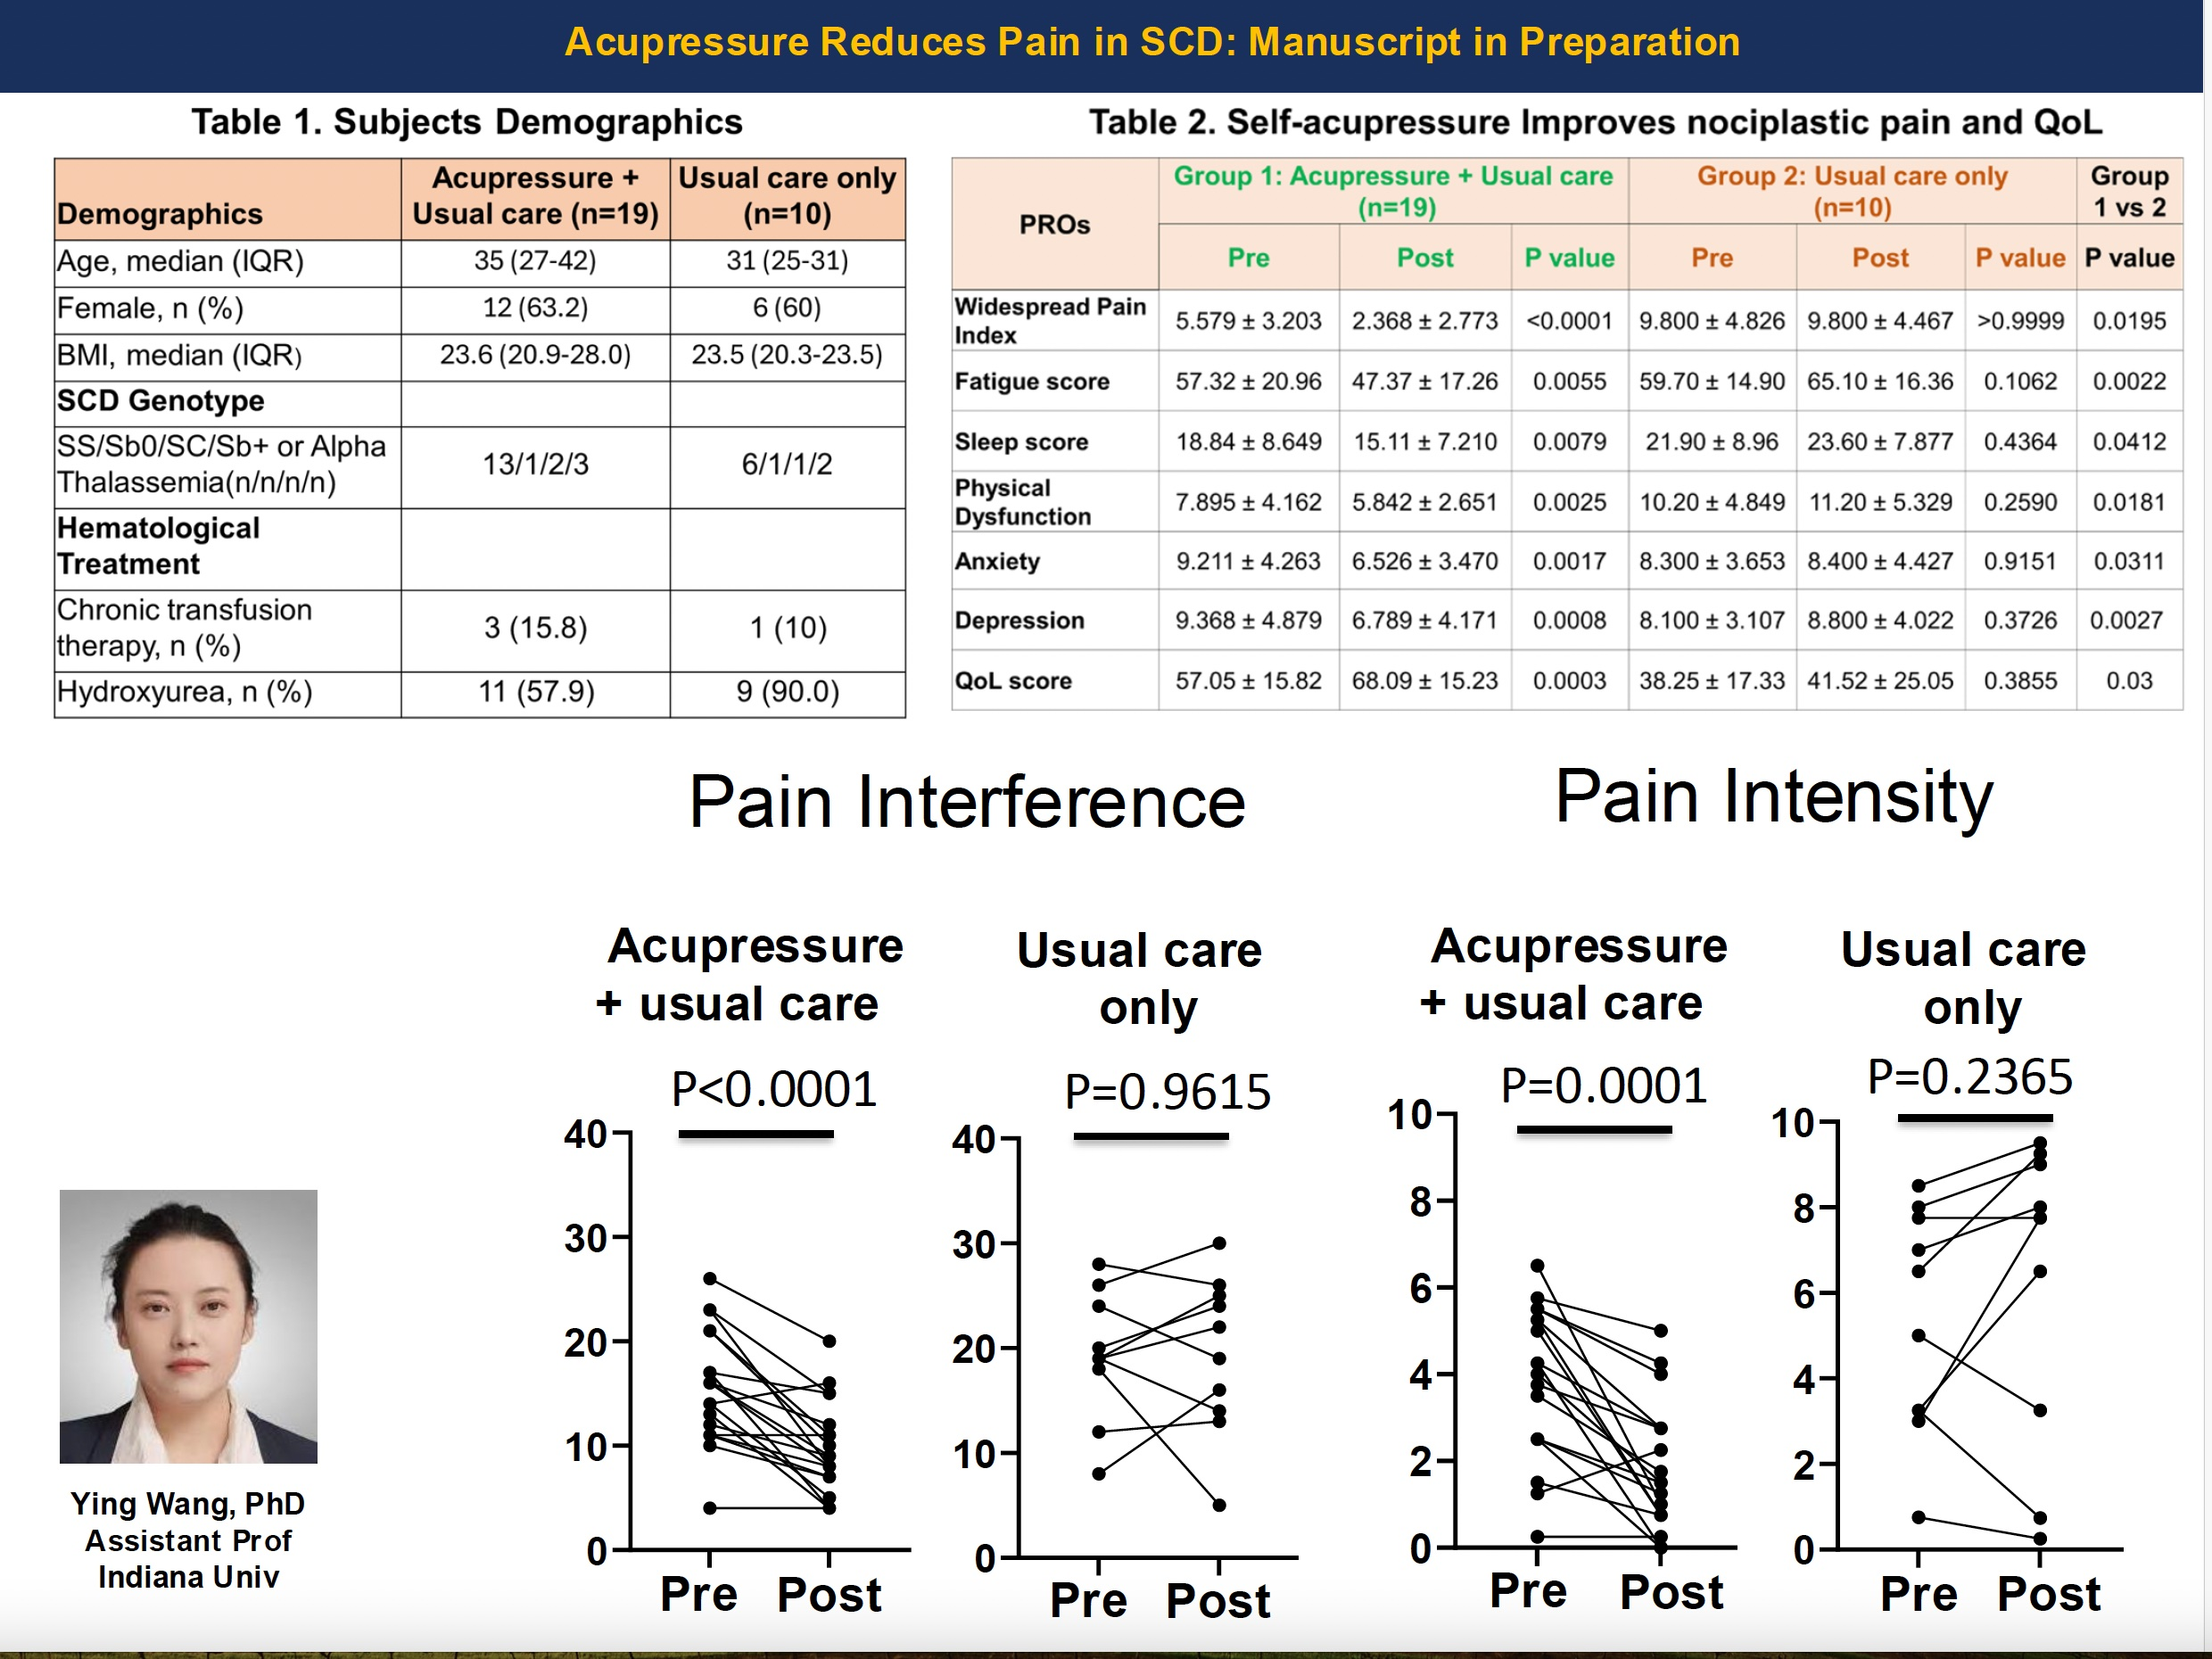

Slide 48
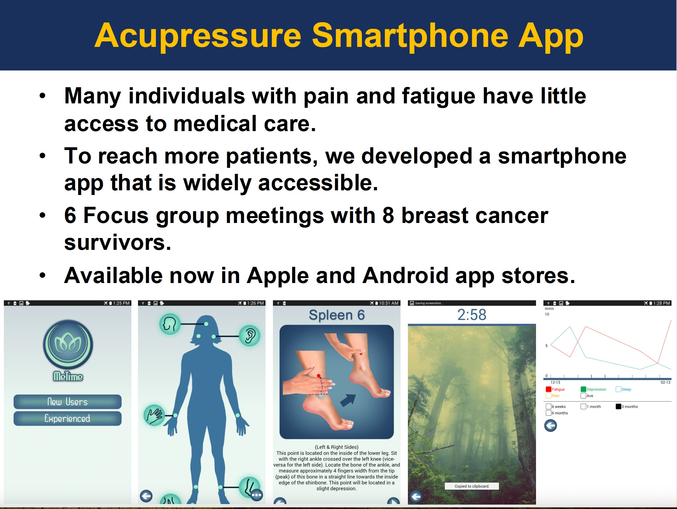

Slide 49
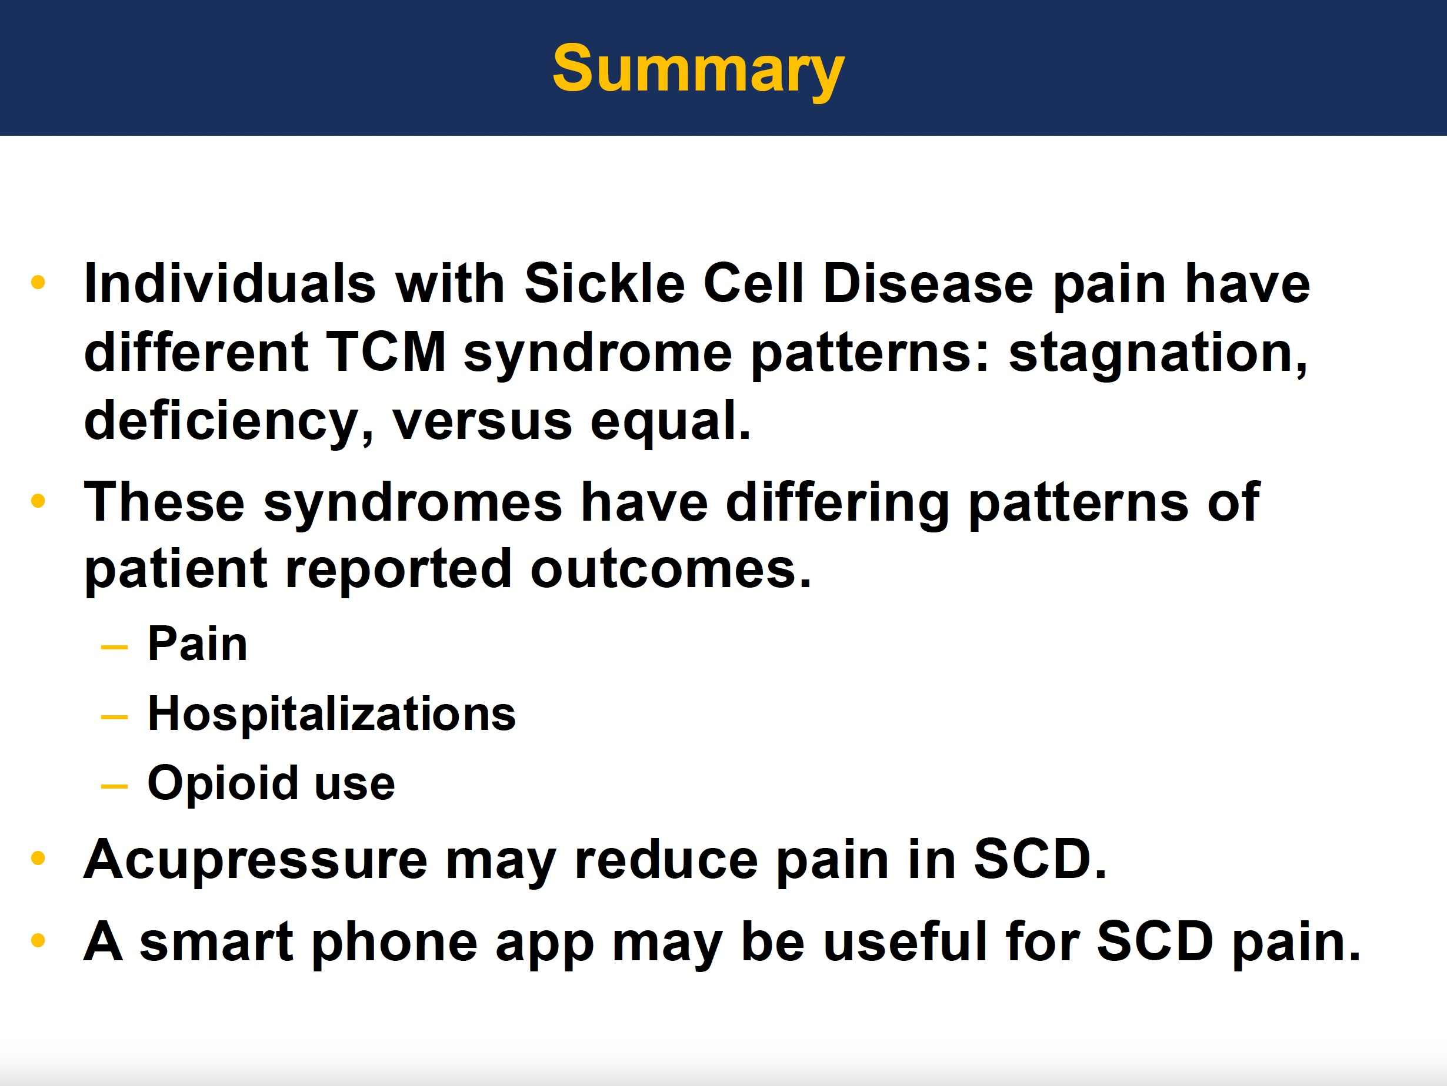

Slide 50
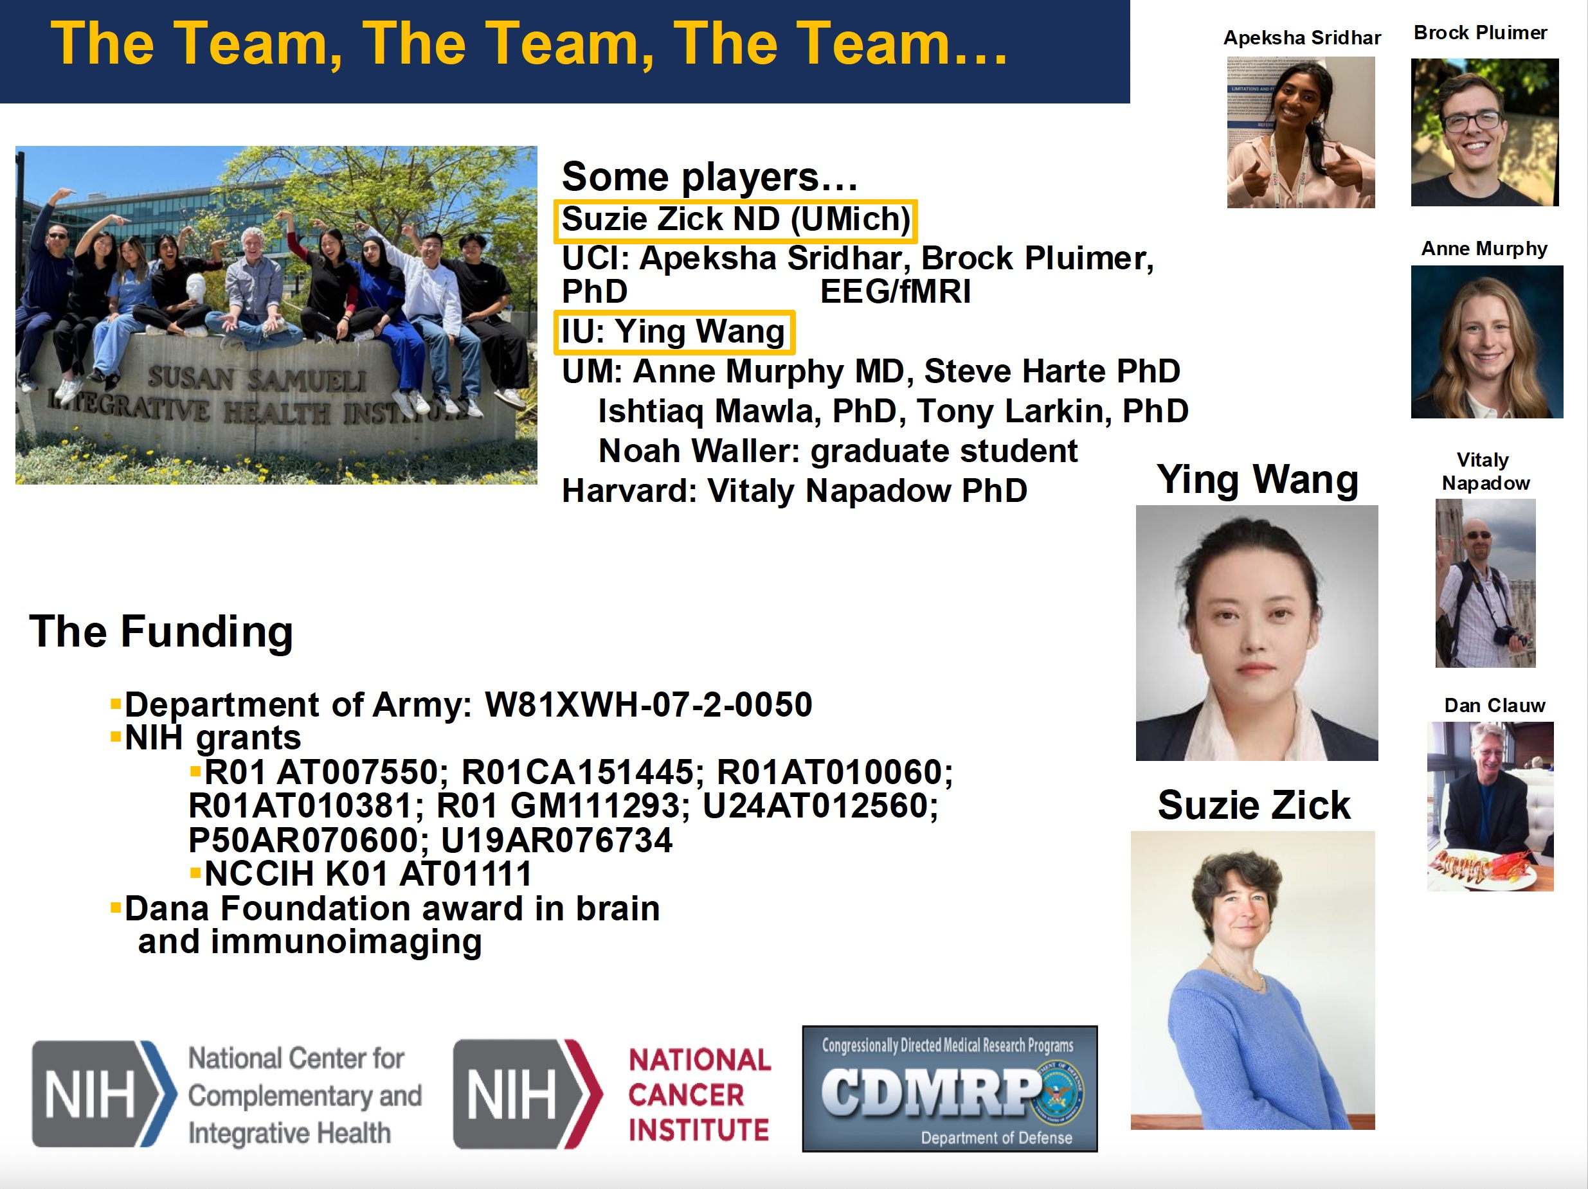

Slide 51


Slide 52

Meeting Research Needs: Sickle Cell Disease Pain as a Whole Person Health Challenge
2025 International Congress on Integrative Medicine and Health, March 7, 2025
Inna Belfer M.D., Ph.D.
Deputy Branch Chief
Basic and Mechanistic Research Branch
National Center for Complementary and Integrative Health
National Institutes of Health
Notes:
Good morning/afternoon. Thank you for the opportunity to present NCCIH’s priorities in supporting SCD Research. I am Inna Belfer, Deputy Branch Chief of Basic and Mechanistic Research Branch at the Division of Extramural Research of National Center for Complementary and Integrative Health (NCCIH) and one of NIH Pain Consortium Representatives.

Slide 53
Disclaimers
I don’t have any conflicts of interests.
This presentation aggregates data from several recent publications on SCD pain with a focus on: Belfer I, Chen W, Weber W, Edwards E, Langevin HM. Unmet Need: Mechanistic and Translational Studies of Sickle Cell Disease Pain as a Whole-Person Health Challenge. J Pain. 2024 Oct;25(10):104603.

Slide 54
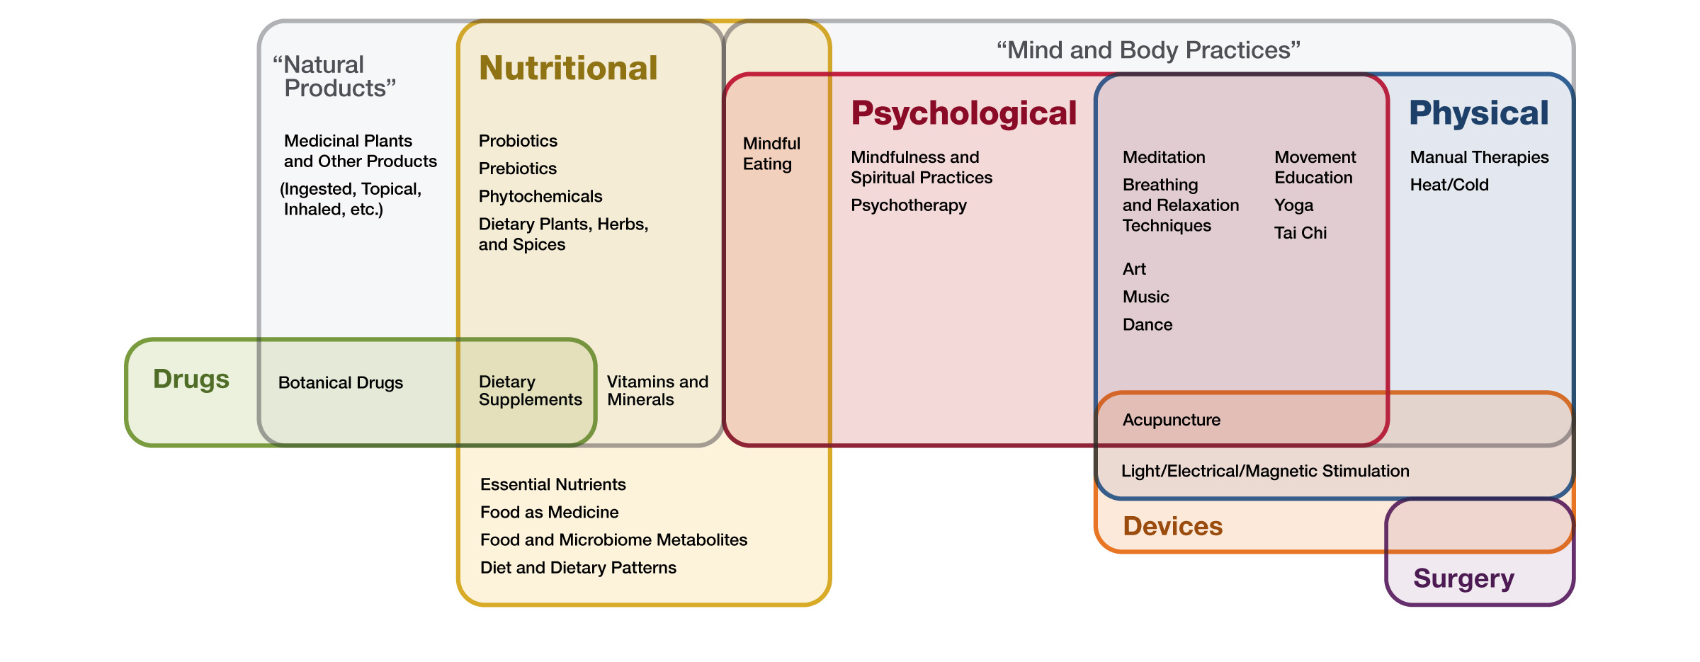
What are complementary and integrative health approaches?
Pitcher MH, Edwards E, Langevin HM, Rusch HL, Shurtleff D. Complementary and integrative health therapies in whole person resilience research. Stress Health. 2023 Sep;39(S1):55-61. doi: 10.1002/smi.3276. Epub 2023 May 27. PMID: 37243503
Notes:
This graphic shows the primary therapeutic input of approaches that may be studied within the NCCIH portfolio.

Slide 55
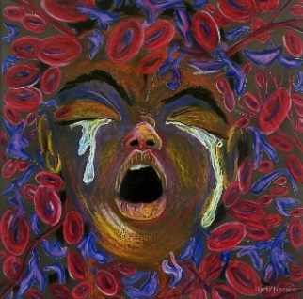
SCD Pain
PAIN
is the most
common
clinical complication of SCD
A. Aich, M.K. Jones, K. Gupta Pain and sickle cell disease. Curr Opin Hematol, 26 (3) (2019), pp. 131-138
§
Severe acute
pain episodes,
chronic
persistent pain, &
neuropathic
pain
“Ten Refined” by Hertz Nazaire
§
Even after
curative therapy
, severe chronic
pain continues
in
40%
of individuals
N.A. Al Hamayel, J.M. Waldfogel, S.M. Hannum, et al. Pain experiences of adults with sickle cell disease and hematopoietic stem cell transplantation: a qualitative study Pain Med, 22 (8) (2021), pp. 1753-1759
Significant impact
of SCD
pain
§
High rates of hospitalizations/ER visits, missed school/work, poor functional &
psychosocial outcomes, & increased rate of mortality
D. Sharma, A.M. Brandow Neuropathic pain in individuals with sickle cell disease Neurosci Lett, 714 (2020).
Complex
pain
management
§
Often doesn’t address comorbidities (e.g., anxiety, stress,
sleep disturbance, SCD complications)
National Academies of Sciences, Engineering, and Medicine. Addressing sickle cell disease: a strategic plan and blueprint for action. Published September 10, 2020. Accessed March 29, 2024.
Notes:
Sickle cell disease (SCD) is a lifelong monogenic, autosomal-recessive blood disease that predominantly affects individuals of African descent

Slide 56
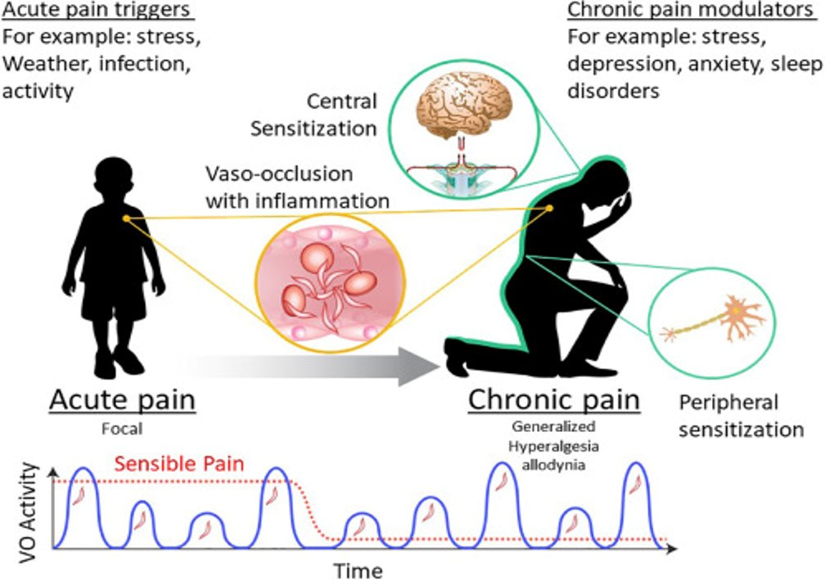
Limited Research on SCD Pain
Ischemic, inflammatory, and neuropathic components
Transition from acute to chronic form
Across the lifespan
Factors influencing SCD pain perception
P. Niscola, F. Sorrentino, L. Scaramucci, P. de Fabritiis, P. Cianciulli
Pain syndromes in sickle cell disease: an update. Pain Med, 10 (3) (2009), pp. 470-480
A.M. Brandow, K.J. Zappia, C.L. Stucky Sickle cell disease: a natural model of acute and chronic pain Pain, 158 (Suppl 1) (2017), pp. S79-S84
B. Nicholson Differential diagnosis: nociceptive and neuropathic pain
Am J Manag Care, 12 (9 Suppl) (2006), pp. S256-262
https://www.jpain.org/article/S1526-5900(18)31017-4/fulltext
Pain Trajectory:
Acute to chronic; Acute on chronic
Notes:
we know much about SCD as a genetic disease, with well-known genetic mutations causing various levels of red blood cells sickling, and established understanding of underlying pathophysiology. However, we do not have this extend of knowledge about SCD pain mechanisms of which are still poorly understood. There is enormous heterogeneity in SCD pain population, as well as within-individual variability. In addition, pain trajectory in SCD is unique and complicated. It always starts with acute pain episode, and the type of pain may change across lifespan. Pediatric pain is characterized by multiple vaso-occlusive pain crises. Most patients develop chronic pain, with sudden acute pain episodes and vaso-occlusive crises occurring on top of chronic persistent pain.

Slide 57
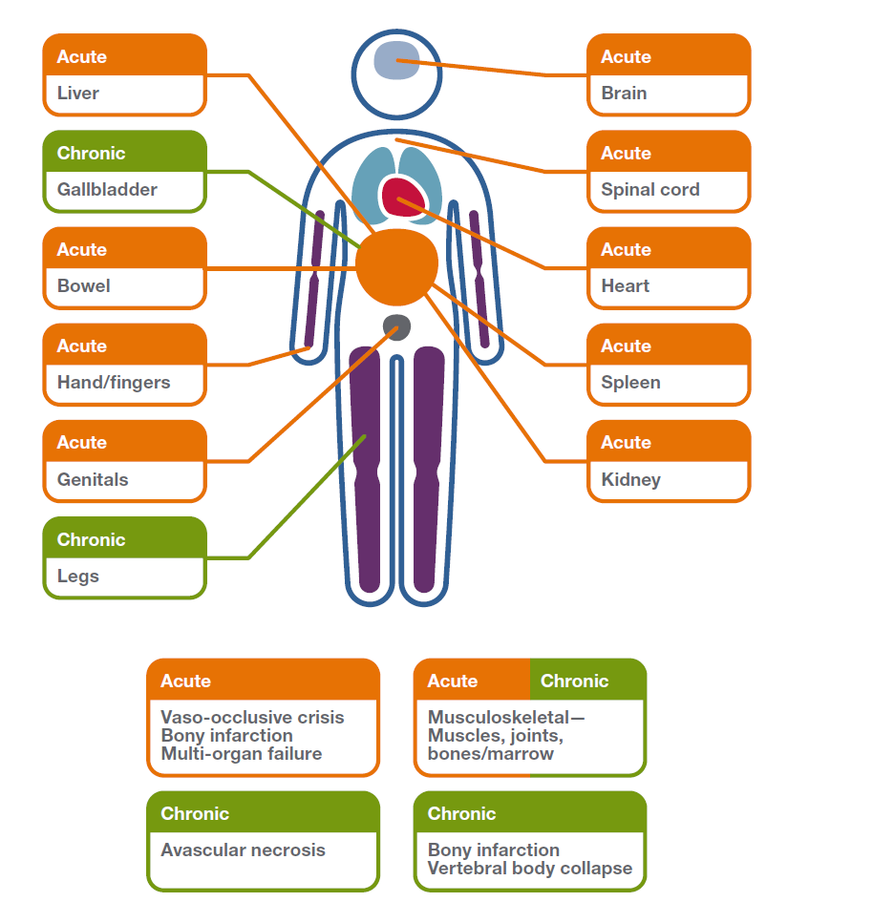
A Multi-Organ Clinical Problem
Figure from Belfer I, Chen W, Weber W, Edwards E, Langevin HM. Unmet Need: Mechanistic and Translational Studies of Sickle Cell Disease Pain as a Whole-Person Health Challenge. J Pain. 2024 Oct;25(10):104603.
G.J. Kato, F.B. Piel, C.D. Reid, et al. Sickle cell disease. Nat Rev Dis Primers, 4 (2018)
M.A. Bender, K. Carlberg Sickle cell disease M.P. Adam, G.M. Mirzaa, R.A. Pagon, et al. (Eds.), GeneReviews® [Internet], University of Washington (2003), pp. 1993-2023
I. Osunkwo, B. Andemariam, C.P. Minniti, et al. Impact of sickle cell disease on patients’ daily lives, symptoms reported, and disease management strategies: results from the international Sickle Cell World Assessment Survey (SWAY) Am J Hematol, 96 (4) (2021), pp. 404-417
M.A. Bender, K. Carlberg Sickle cell disease M.P. Adam, G.M. Mirzaa, R.A. Pagon, et al. (Eds.), GeneReviews® [Internet], University of Washington (2003), pp. 1993-2023
Notes:
On clinical level – SCD pain, both acute and chronic is multi-organ problem. Due to organ damage caused by SCD, many patients report acute pain in their liver, spleen, kidney, intestine , chest, hands and genitals. Also, they may have severe headaches and central pain due to the strokes. Acute pain episodes are caused by VOC, bone infractions and multi-organ failure. Chronic pain often happens in gallbladder and legs resulting from avascular necrosis and bony infractions. Recently, several studies pointed musculoskeletal pain in patients with SCD. This pain is believed to reflect acute and chronic injuries to muscles, joints and bones.

Slide 58

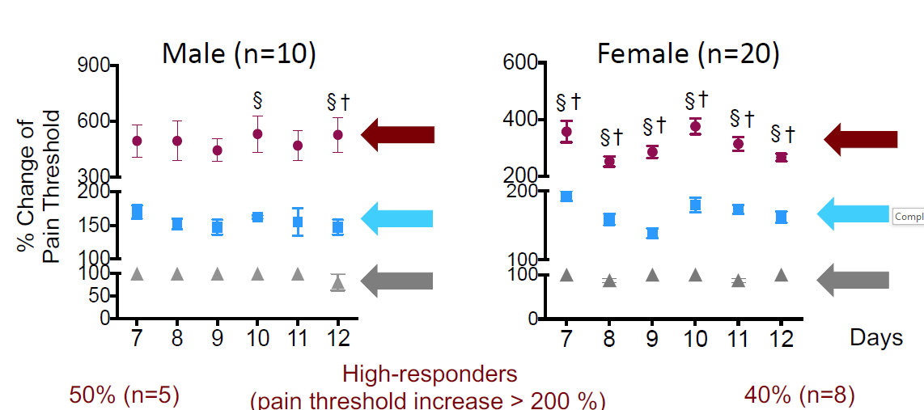
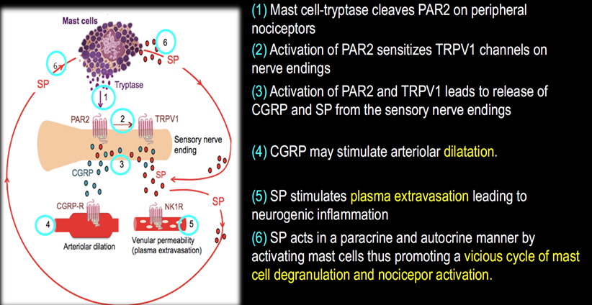
Most Animal Studies of SCD Pain Focus on Skin, Not an Organ Impacted in SCD Patients
Mast cell activation leads to pain
Sensitization of sensory nerve fibers (neuropathic pain)
Variable response to electroacupuncture
Vincent et al, Blood. 2013
Kenyon et al, 2015
Wang et al., 2016
SKIN
SKIN
SPINAL CORD, SKIN
Notes:
One of the biggest problems is that preclinical studies of organ damage in SCD do not measure pain. MOST ANIMAL STUDIES OF SCD PAIN FOCUS ON SKIN, NOT AN ORGAN IMPACTED IN SCD PATIENTS . For example, studies on mast cell activation causing SCD pain were done in rodents using skin preps. Studies focusing on sensitization of sensory nerve fibers were done in skin of sickle mice. Interventions study of the sickle mice response to electroacupuncture were also done in skin.

Slide 59
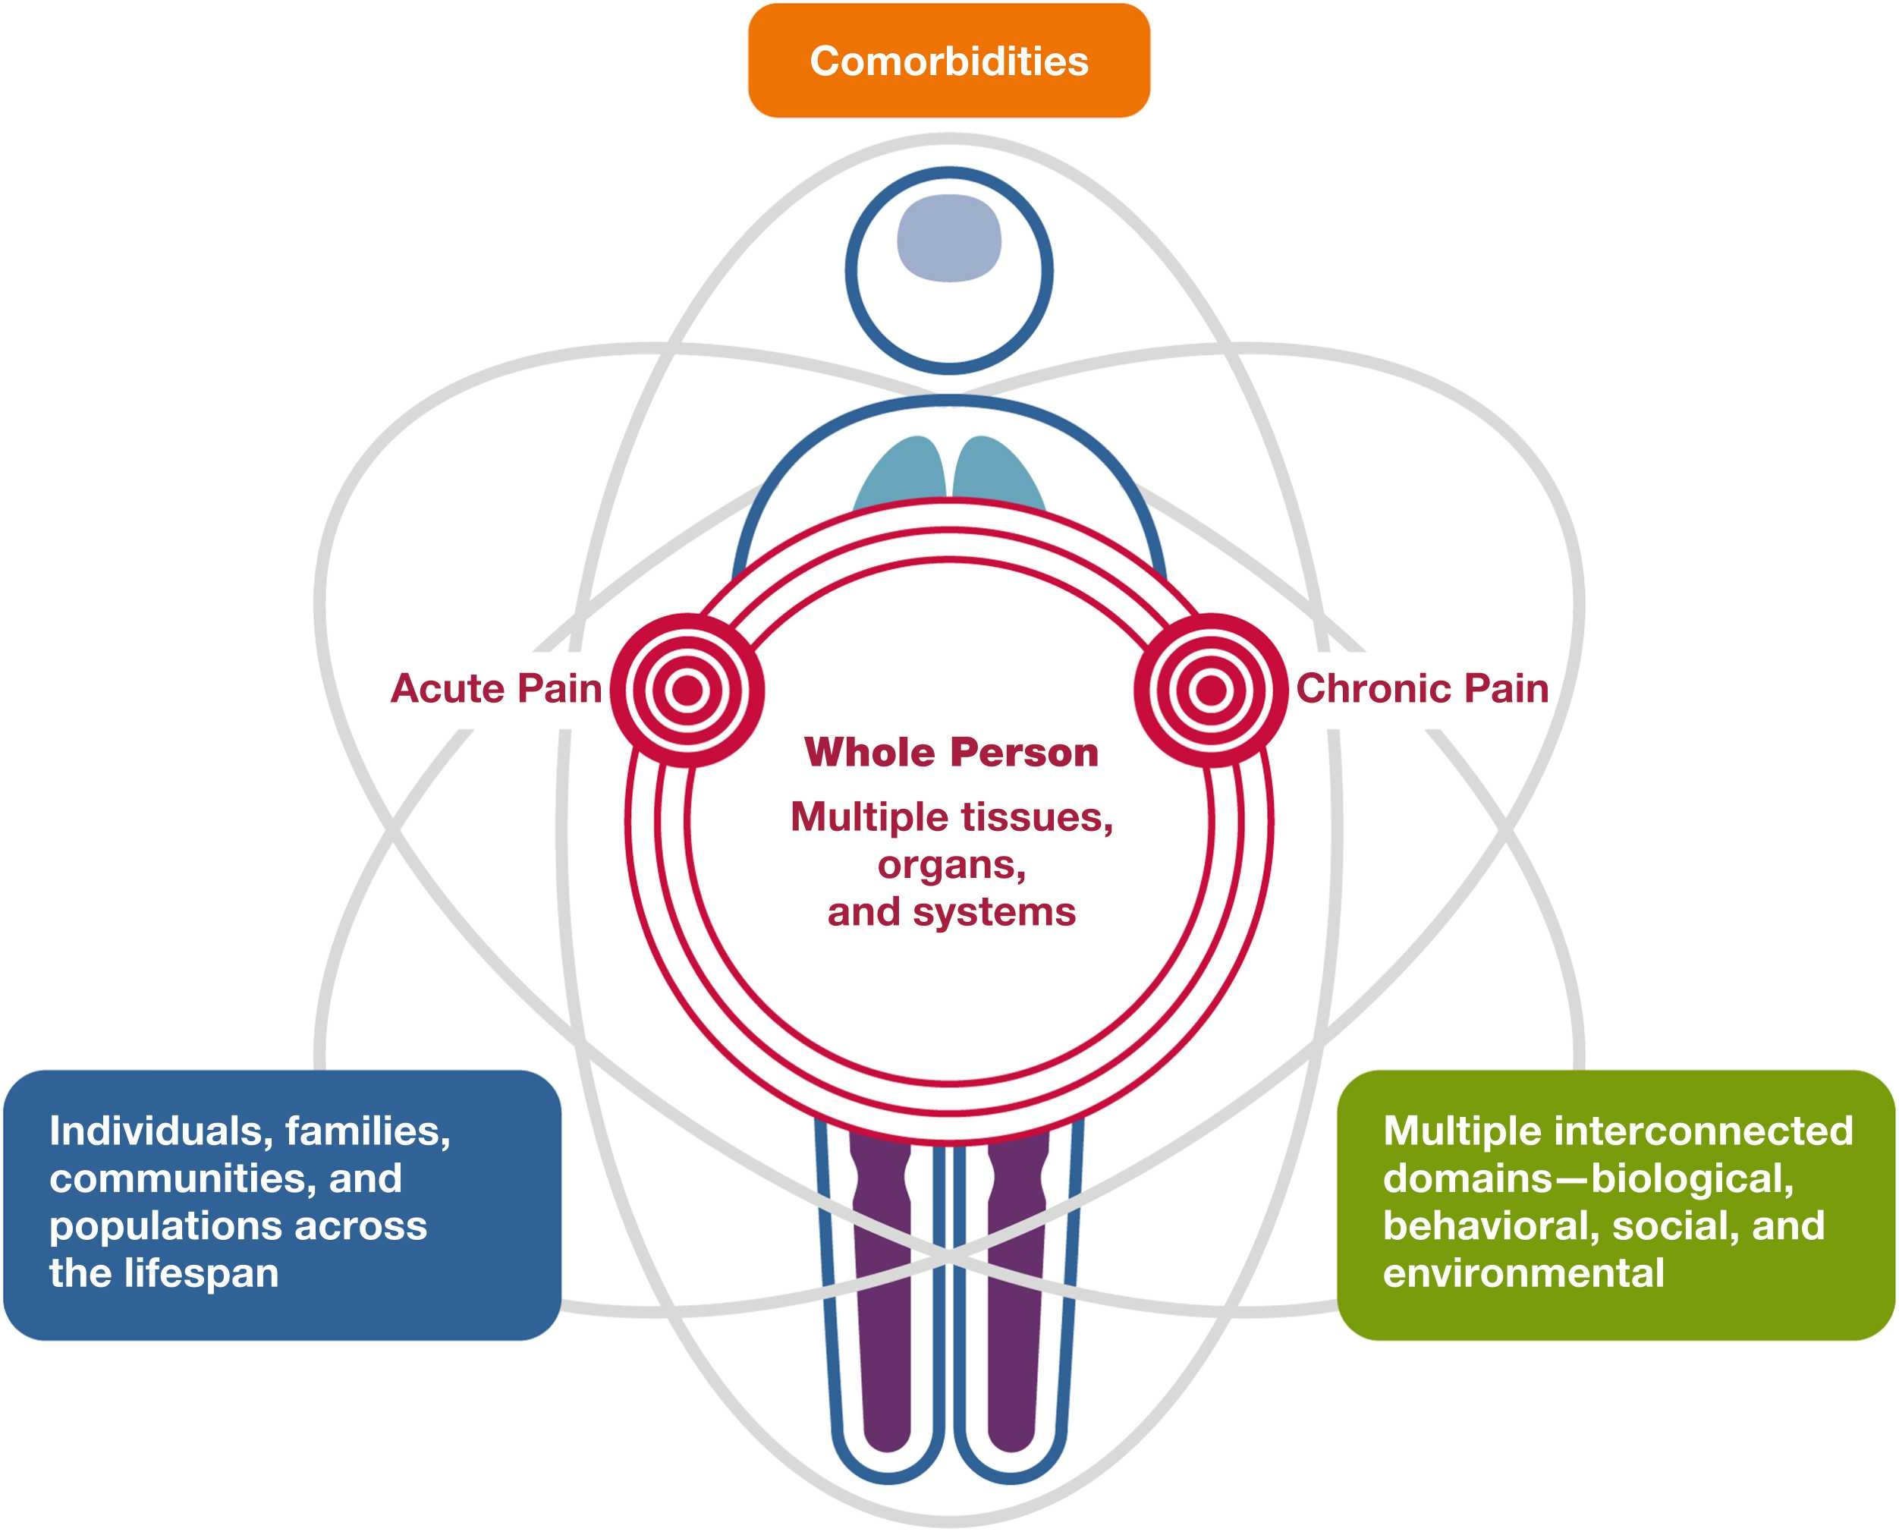
Figure from Belfer I, Chen W, Weber W, Edwards E, Langevin HM. Unmet Need: Mechanistic and Translational Studies of Sickle Cell Disease Pain as a Whole-Person Health Challenge. J Pain. 2024 Oct;25(10):104603.
Notes:
Another problem is limited understanding that pain in individuals with SCD is a complex problem that affects multiple tissues, organs, and systems and is influenced by multiple biopsychosocial factors, operating at a variety of levels..

Slide 60




Meeting Research Needs
SCD Pain: a Whole Person Health Challenge
Framework
Develop framework to enable translational and reverse translational studies
Interventions
Non-addictive pharmacologic therapies
Complementary interventions
Integrative health interventions
Whole-person interventions
Technology
Humanized animal model
Muscle, bone, joint, visceral models
Mechanism-based pain phenotyping
Human tissues (DRGs, iPSC cells)
Omics, microbiome, neuroimaging
Longitudinal designs
People/Expertise
Hematologists, organ biologists, pain experts, physiologists, neuroscientists, psychologists, geneticists, microbiologists, immunologists, behavioral scientists, clinicians
Belfer I, Chen W, Weber W, Edwards E, Langevin HM. Unmet Need: Mechanistic and Translational Studies of Sickle Cell Disease Pain as a Whole-Person Health Challenge. J Pain. 2024 Oct;25(10):104603.
Notes:
Treating SCD pain as a Whole Person Health Challenge may lead to optimization of current treatment strategies and the development of novel therapies for SCD pain.

Slide 61
Collaborators
Dr. Wen Chen
Dr. Wendy Weber
Dr. Emmeline Edwards
Dr. Helene M. Langevin
Contact: 301-435-1573
inna.belfer@nih.gov

